Slide 1

SIL Beta Demo Model
Presented by:
Data Science (Bhuvanesh)
31st July 2025

Slide 2
Architecture Overview of TDB’s Risk Scorecards
For Cash Loan only
For both Cash and SIL
Limit Setting Model (Hosted in Digital Layer)
Credit Decisioning Model (Hosted in Taran)
Beta Stack
Alpha Stack
Trench 1: New Users - within 30 days from TSA Onboarding
Limit Setting Score = Gamma Stack
Beta Demo Score
Beta Demo Score
Gamma Demo Score
Apps Score
Selectively call Alpha
Apps Score
Apps Score
Credo Score
Users automatically move from Trench 1 to Trench 2 after 30 days if no disbursed loans
Credo Score
CIC Score
Gamma Income Model
Beta Income Model
Alpha Income Model
Users will stay in Trench 2 until 1st disbursed loan. His Gamma Stack will be re-calculated every 30-day anniversary from TSA onboarding date
Limit Setting Score = Gamma Stack
Beta Stack
Alpha Stack
Gamma Demo Score
Beta Demo Score
Beta Demo Score
Trench 2: Existing Users - After 30 days from TSA Onboarding AND Never Disbursed Loan
Selectively call Alpha
Apps Score
Apps Score
Apps Score
Transaction Score
Transaction Score
Transaction Score
CIC Score
Gamma Income Model
Beta Income Model
Alpha Income Model
Users will move to Trench 3 after 1st Disbursed Loan
Lowest Risk users from this B Score will be pre-approved for upsell and xsell. Medium Risk users from this B Score will have to go through Taran.
High Risk users from this B Score will not be given any offer.
B Score = Gamma Stack
Trench 3: Existing Users - After 30 days from 1st Disbursed Loan AND current DPD <= 10
Beta Stack
Alpha Stack
Gamma Demo Score
Apps Score
Beta Demo Score
Selectively call Alpha
Beta Demo Score
Apps Score
Apps Score
Enhanced Transaction Score
Enhanced Transaction Score
Once moved to Trench 3, user will forever remain in Trench 3. His Gamma Stack will be re-calculated every 30 days anniversary from 1st Loan Disbursement Date
Enhanced Transaction Score
CIC Score
Gamma Income Model
Beta Income Model
Alpha Income Model

Slide 3
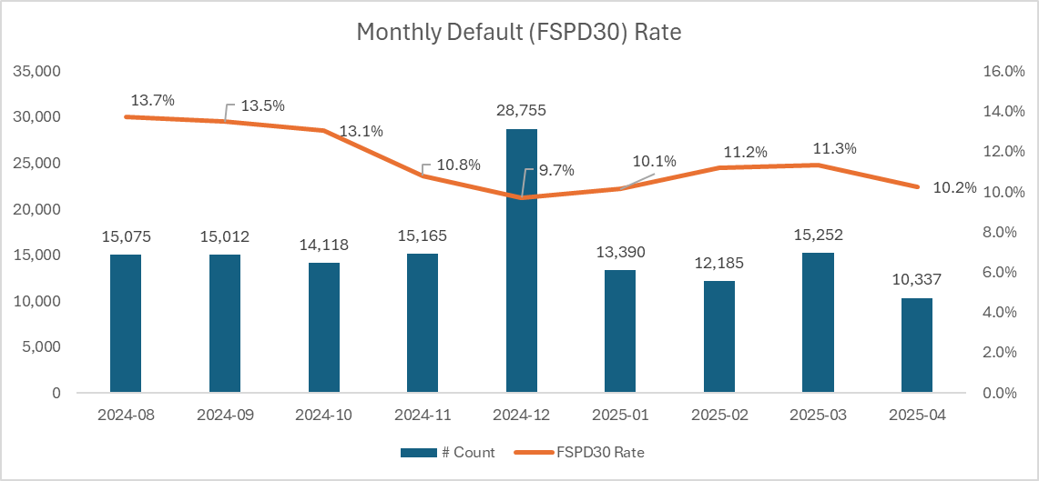
Cash Beta Demo Model: only Quick and Flex loans were considered
 | Loan Disbursement Date | # Count | # Bad (FSPD30) Quick Loans | FSPD30 rate
Training (90%) | 01/08/2024 - 31/01/2025 | 91,363 | 10,599 | 0.1160
Validation (10%) | 01/08/2024 - 31/01/2025 | 10,152 | 1,133 | 0.1116
Test (Feb) | 01/02/2025 - 28/02/2025 | 12,185 | 1,362 | 0.1118
OOT (Mar) | 01/03/2025 - 31/03/2025 | 15,252 | 1,728 | 0.1133
OOT (Apr) | 01/04/2025 - 21/04/2025 | 10,337 | 1,059 | 0.1024
3

Slide 4
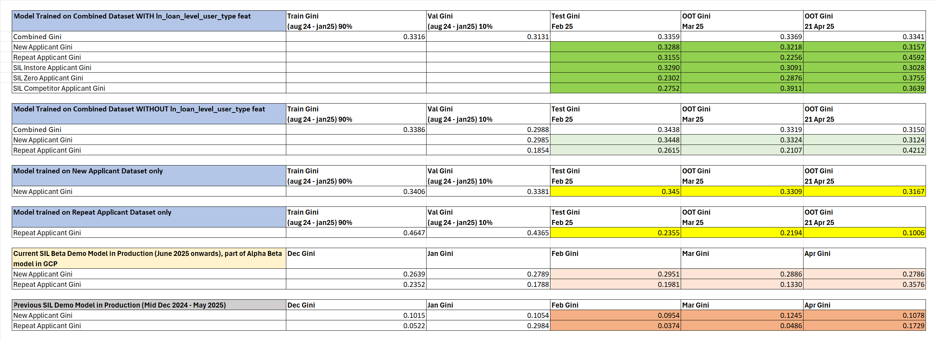
After lot of experimentations, the Model trained on combined dataset (new applicant + repeat applicant) along with the user_type feature showed the best performance and stability

Slide 5
Feature Selection Methodology Overview
Feature Selection Methodology Overview
36
Feats
27
Feats
27 Feats
27 Feats
15 Feats
IV > 0.01
Missing Rate < 95%
Inter-correlation < 75%
Individual Feature Evaluation

Slide 6
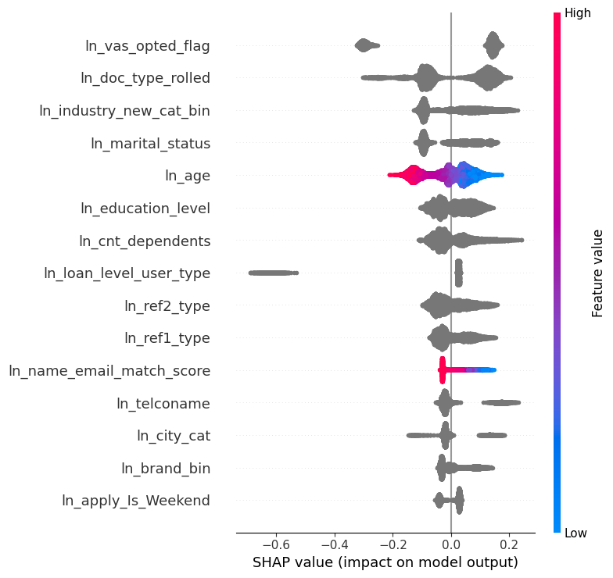
SHAP ( 15 feat )
The horizontal axis shows how much a feature affects the prediction. Points to the right mean the feature increases the prediction, and points to the left mean it decreases it.
The color of each dot shows the feature value: red means the value is high, and blue means the value is low.
If red dots are mostly on the right, it means high values of that feature increase the prediction. If red dots are on the left, high values decrease the prediction.
The features are listed on the vertical axis, from most important at the top to least important at the bottom.

Slide 7
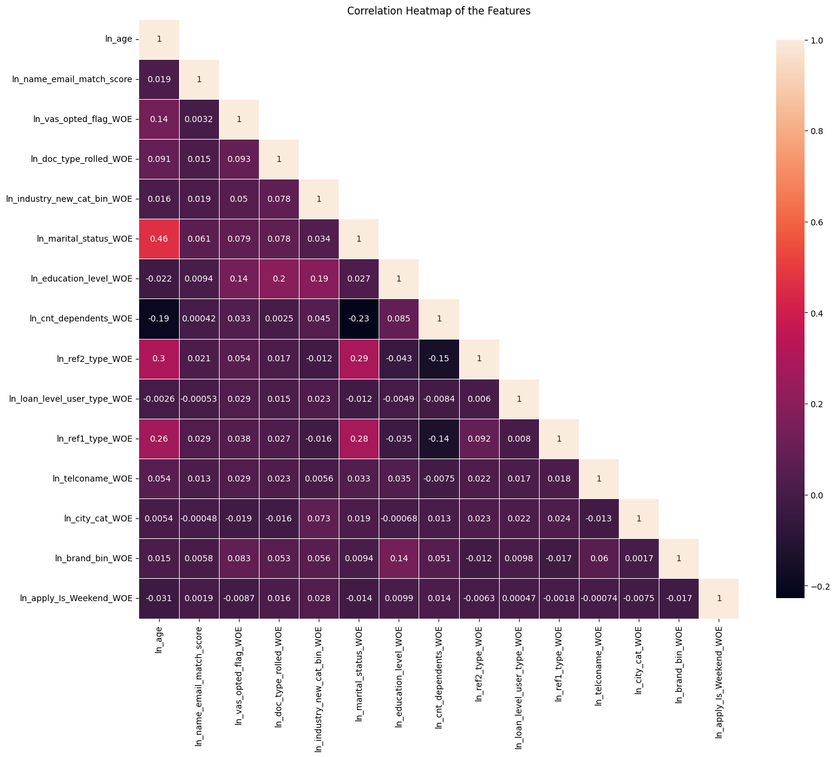
Inter-Correlation ( 15 feat )
From the correlation plot, we can see that the highest correlation is between ln_age and ln_marital_status, at 46%, followed by ln_age and ln_ref2_type at 30%.
These are the maximum correlations observed, and no other feature pairs show particularly high values.
The numbers in the plot indicate how strongly two features are related — values close to 1 suggest a strong positive correlation (both features increase together),
while values close to -1 imply a strong negative correlation (one increases while the other decreases).

Slide 8
Model Iteration | Features | Train (90%) Gini (Aug24 - Jan25) | Val (10%) Gini (Aug24 - Jan25) | Test Gini (Feb25) | OOT Gini (Mar25) | OOT Gini (Until 21st Apr25)
Model with top 5 feat | ln_vas_opted_flag, ln_doc_type_rolled, ln_industry_new_cat_bin, ln_marital_status, ln_age | 0.2584 | 0.2527 | 0.2868 | 0.2831 | 0.2642
Model with top 6 feat | ln_education_level | 0.2738 | 0.2666 | 0.2966 | 0.2840 | 0.2786
Model with top 7 feat | ln_cnt_dependents | 0.2810 | 0.2772 | 0.2992 | 0.2907 | 0.2885
Model with top 8 feat | ln_ref2_type | 0.2907 | 0.2907 | 0.3060 | 0.2999 | 0.2933
Model with top 9 feat | ln_loan_level_user_type | 0.3015 | 0.3016 | 0.3162 | 0.3156 | 0.3100
Model with top 10 feat | ln_ref1_type | 0.3137 | 0.3032 | 0.3257 | 0.3235 | 0.3281
Model with top 11 feat | ln_name_email_match_score | 0.3141 | 0.2992 | 0.3245 | 0.3286 | 0.3244
Model with top 12 feat | ln_telconame | 0.3198 | 0.3017 | 0.3268 | 0.3295 | 0.3261
Model with top 13 feat | ln_city_cat | 0.3251 | 0.3035 | 0.3310 | 0.3334 | 0.3296
Model with top 14 feat | ln_brand_bin | 0.3248 | 0.3039 | 0.3323 | 0.3325 | 0.3290
Model with top 15 feat | ln_apply_Is_Weekend | 0.3278 | 0.3066 | 0.3341 | 0.3349 | 0.3306
15 feature model after Hyper Parameters Tuning | New + Repeat Applicant | 0.3316 | 0.3131 | 0.3359 | 0.3369 | 0.3341
 | New Applicant | 0.3216 | 0.3049 | 0.3288 | 0.3218 | 0.3157
 | Repeat Applicant | 0.4254 | 0.1023 | 0.3155 | 0.2256 | 0.4592
 | SIL Instore Applicant | 0.3248 | 0.3054 | 0.3290 | 0.3091 | 0.3028
 | SIL Zero Applicant | 0.3679 | 0.3357 | 0.2302 | 0.2876 | 0.3755
 | SIL Competitor Applicant | 0.3657 | 0.3795 | 0.2752 | 0.3911 | 0.3639
Hyperparameter | Value
learning_rate | 0.03504401000047882
depth | 5
l2_leaf_reg | 3.2160311089960776
iterations | 2000
eval_metric | AUC
random_seed | 42
auto_class_weights | Balanced
early_stopping_rounds | 10
Hyperparameter values for the best model chosen after the HP Tuning using Optuna
8

Slide 9
SHAP Ranks are overall consistent Across Training, Test and OOT Windows
feature | Train Rank (Aug24 - Jan25) | Test Rank (Feb25) | OOT1 Rank (Mar25) | OOT2 Rank (Until 21st Apr25)
ln_vas_opted_flag | 1 | 1 | 1 | 1
ln_doc_type_rolled | 2 | 2 | 2 | 2
ln_industry_new_cat_bin | 3 | 3 | 3 | 3
ln_marital_status | 4 | 4 | 4 | 4
ln_age | 5 | 5 | 5 | 5
ln_education_level | 6 | 6 | 6 | 7
ln_cnt_dependents | 7 | 7 | 8 | 8
ln_ref2_type | 8 | 8 | 9 | 9
ln_loan_level_user_type | 9 | 9 | 7 | 6
ln_ref1_type | 10 | 10 | 10 | 10
ln_name_email_match_score | 11 | 11 | 11 | 11
ln_telconame | 12 | 12 | 12 | 12
ln_city_cat | 13 | 13 | 15 | 14
ln_brand_bin | 14 | 14 | 14 | 13
ln_apply_Is_Weekend | 15 | 15 | 13 | 15
9

Slide 10
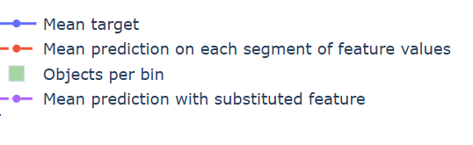
Feature Stability Plot Legend Table
Symbol / Line | Name | What It Shows | How to Interpret
🔷 Blue Line | Mean Target | Average true target (e.g., default rate) in each bin of the feature | 📈 Spiky → Target is unstable or noisy 📉 Smooth → Target changes consistently
🔴 Red Dashed Line | Mean Prediction | Model's average predicted score in each bin | Should generally follow blue line Slightly smoother → Model generalizes to avoid overfitting
🟩 Green Bars | Objects per Bin | Count of data points in each bin | High = reliable signal ⚠️ Very low = sparse data = risk of overfitting or unreliable predictions
🟣 Purple Dotted Line | Mean Prediction with Substituted Feature | Prediction if this feature was shuffled or replaced randomly | Closer to red = model doesn’t rely much on feature Further from red = model depends heavily on feature
10

Slide 11
Feature Evaluation Plots (15 features)

Slide 12
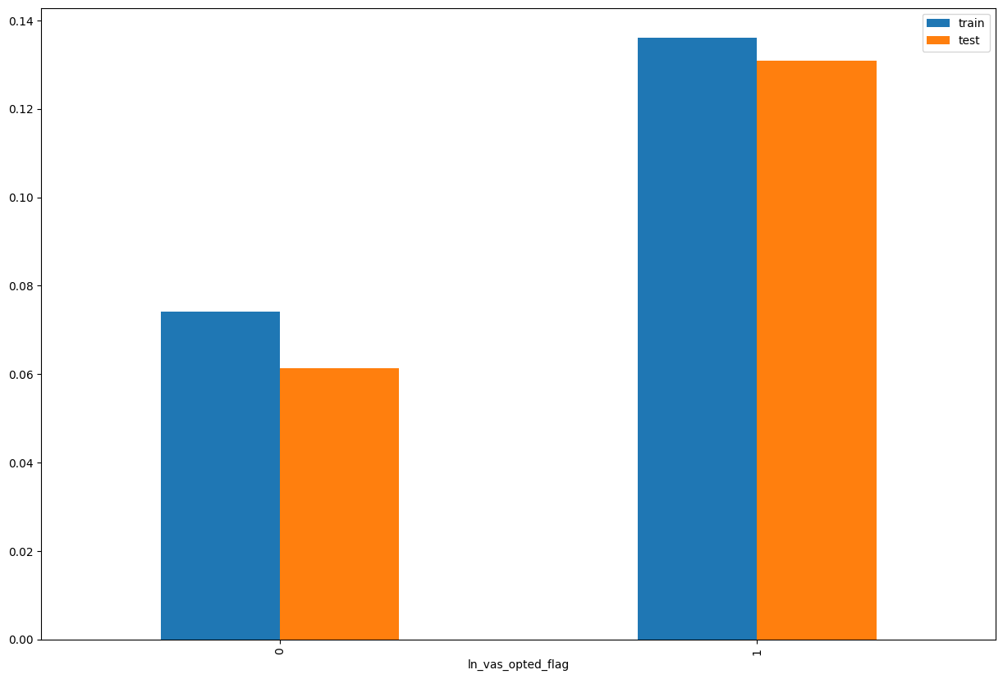
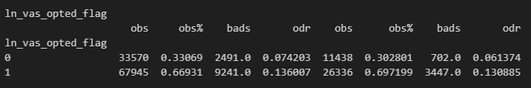
Rank# 1: ln_vas_opted_flag ( 1 / 5 ) - Feature Performance in Train vs Test <Disbursed>
Indicates whether the user has opted for any value-added services, such as PayHinga (payment holiday feature).

Slide 13
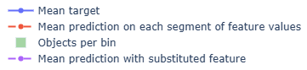
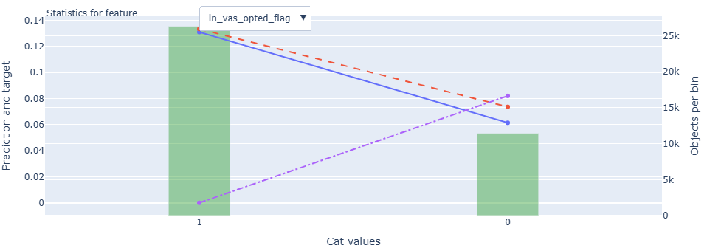
Rank# 1: ln_vas_opted_flag ( 2 / 5 ) - Feature Statistics Analysis <Disbursed>
The model appears to utilize this feature meaningfully, as indicated by the red prediction line tracking the blue target trend.
A strong visible gap between the red and purple lines confirms this feature enhances the model's predictive capability.
The distribution of records is skewed—more samples fall under category 1 (VAS opted) compared to category 0.
The target (not disbursed) rate increases when VAS is not opted (value 0), indicating a negative relationship with VAS adoption.
13

Slide 14
Rank# 1: ln_vas_opted_flag ( 3 / 5 ) - MoM Feature Distribution <Applied>
ln_vas_opted_flag | Applied Count | Approval Rate | 1 | 0 |  | Avg. Demo Score
2024-08 | 25,136 | 60.0% | 70.7% | 29.3% |  | 0.49806503
2024-09 | 25,284 | 59.4% | 71.3% | 28.7% |  | 0.49974565
2024-10 | 23,980 | 58.9% | 70.2% | 29.8% |  | 0.49468015
2024-11 | 24,399 | 62.2% | 68.6% | 31.4% |  | 0.48374065
2024-12 | 48,407 | 59.4% | 69.1% | 30.9% |  | 0.48802628
2025-01 | 23,044 | 58.1% | 70.7% | 29.3% |  | 0.49425928
2025-02 | 20,636 | 59.0% | 73.6% | 26.4% |  | 0.49441829
2025-03 | 25,000 | 61.0% | 73.4% | 26.6% |  | 0.48966094
2025-04 | 26,389 | 62.3% | 73.1% | 26.9% |  | 0.48805174
2025-05 | 26,406 | 61.8% | 72.8% | 27.2% |  | 0.48956425
2025-06 | 22,903 | 65.3% | 71.5% | 28.5% |  | 0.48503991
2025-07 | 16,160 | 64.7% | 71.0% | 29.0% |  | 0.48868890
The opt-in rate (value = 1) remains consistently high, fluctuating between 68.6% and 73.6%, with a recent rise in Feb–Apr 2025 and slight tapering to 71.0% by Jul 2025, reflecting stable user engagement with the VAS offering.
The non-opted group (value = 0) inversely tracks in a narrow band from 26.4% to 31.4%, maintaining a balanced and predictable shift over the period without any erratic changes.
This steady pattern, absent of volatility or sudden spikes, confirms the feature’s stability and reliability for modeling user preferences.
14

Slide 15
Rank# 1: ln_vas_opted_flag ( 4 / 5 ) - MoM Feature Distribution <Applied> <User Type wise>
New Applicant
ln_vas_opted_flag | Applied Count | Approval Rate | 1 | 0 |  | Avg. Demo Score
2024-08 | 24,489 | 59.7% | 71.0% | 29.0% |  | 0.50401733
2024-09 | 24,586 | 59.2% | 71.5% | 28.5% |  | 0.50623264
2024-10 | 23,174 | 58.5% | 70.5% | 29.5% |  | 0.50243876
2024-11 | 23,342 | 61.6% | 69.0% | 31.0% |  | 0.49347179
2024-12 | 46,925 | 59.3% | 69.3% | 30.7% |  | 0.49474936
2025-01 | 22,214 | 58.2% | 71.2% | 28.8% |  | 0.50244124
2025-02 | 19,736 | 59.2% | 73.9% | 26.1% |  | 0.50413760
2025-03 | 23,809 | 61.0% | 73.7% | 26.3% |  | 0.50027591
2025-04 | 25,098 | 62.1% | 73.2% | 26.8% |  | 0.49865757
2025-05 | 25,382 | 61.8% | 73.0% | 27.0% |  | 0.49802064
2025-06 | 21,852 | 65.3% | 71.7% | 28.3% |  | 0.49488959
2025-07 | 15,520 | 64.4% | 71.2% | 28.8% |  | 0.49704827
Repeat Applicant
ln_vas_opted_flag | Applied Count | Approval Rate | 1 | 0 |  | Avg. Demo Score
2024-08 | 647 | 71.9% | 62.1% | 37.9% |  | 0.27276985
2024-09 | 698 | 66.0% | 64.2% | 35.8% |  | 0.27125114
2024-10 | 806 | 70.0% | 61.5% | 38.5% |  | 0.27160578
2024-11 | 1,057 | 75.6% | 58.8% | 41.2% |  | 0.26884544
2024-12 | 1,482 | 60.7% | 61.7% | 38.3% |  | 0.27515154
2025-01 | 830 | 56.4% | 57.6% | 42.4% |  | 0.27527841
2025-02 | 900 | 55.1% | 66.0% | 34.0% |  | 0.28128463
2025-03 | 1,191 | 61.2% | 67.0% | 33.0% |  | 0.27745954
2025-04 | 1,291 | 65.4% | 71.5% | 28.5% |  | 0.28186643
2025-05 | 1,024 | 63.5% | 69.3% | 30.7% |  | 0.27995464
2025-06 | 1,051 | 66.7% | 68.1% | 31.9% |  | 0.28024897
2025-07 | 640 | 73.6% | 66.4% | 33.6% |  | 0.28031537
Opt-in behavior for new applicants is robust, gradually climbing from 69.0% in Nov 2024 to a peak of 73.9% in Feb 2025, before easing slightly to 71.2% by Jul 2025, indicating strong and sustained feature adoption.
Non-opted rates remain low and predictable, within a tight range of 26.1% to 31.0%, reinforcing the smooth and consistent month-to-month distribution.
The trend shows no signs of disruption, making this feature both stable and representative of new applicant behavior over time.
Repeat applicants show more variance, with opt-in rates ranging from a low of 57.6% in Jan 2025 to a high of 71.5% in Apr 2025, yet recovering strongly in recent months, ending at 66.4% in Jul 2025.
The share of non-opted users peaked at 42.4% in Jan 2025 but dropped steadily to 33.6% by Jul 2025, reflecting a gradual normalization post-fluctuation.
While there's some early-month volatility, the recent trend exhibits increasing consistency, making the feature progressively more reliable for repeat user modeling.
15

Slide 16
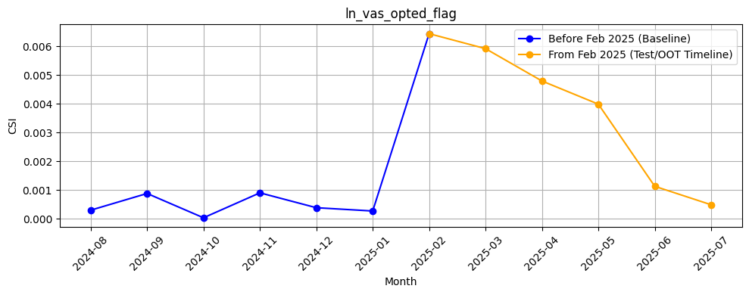
Rank# 1: ln_vas_opted_flag ( 5 / 5 ) - Feature CSI Analysis <Applied>
Baseline period (Aug 2024 to Jan 2025) shows very low CSI values, indicating strong feature stability.
A slight rise in CSI was observed in Feb 2025 (~0.0065), followed by a steady decline through Jul 2025.
CSI remained well below the 0.1 threshold throughout, confirming no significant data drift.

Slide 17
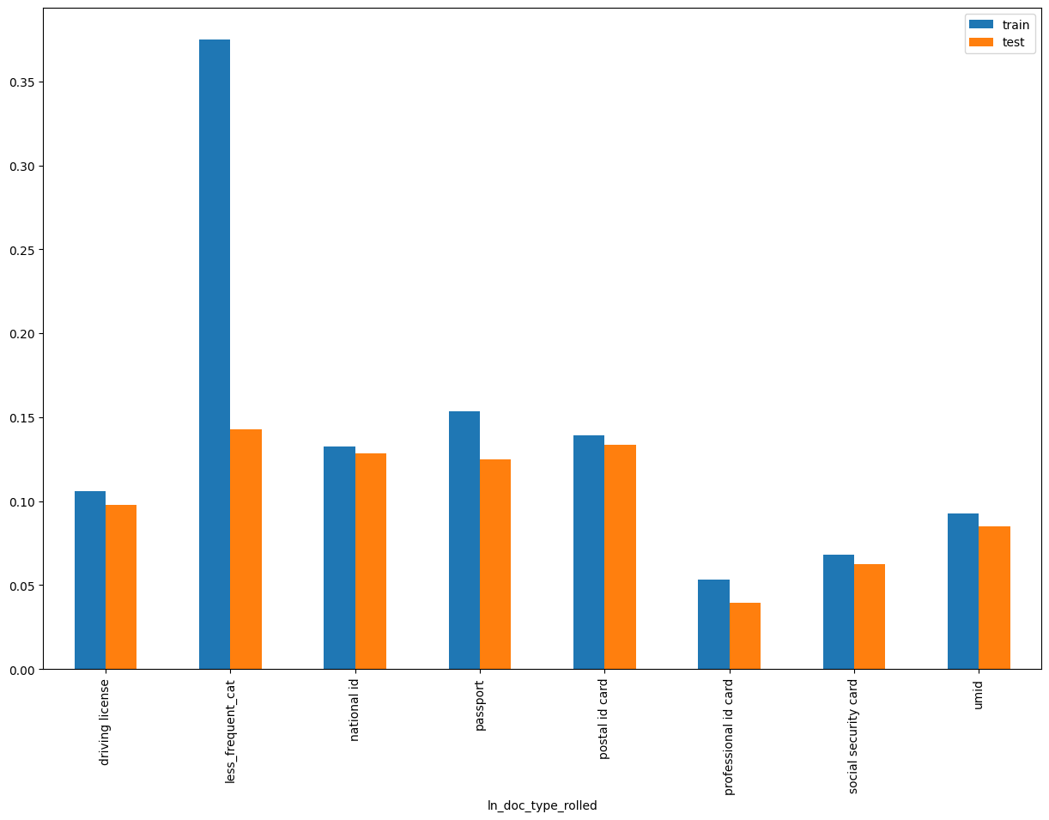
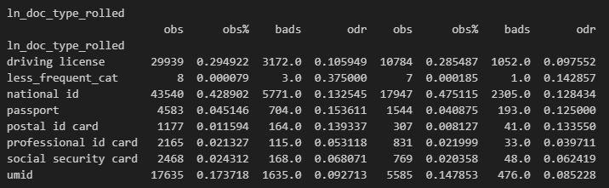
Rank# 2: ln_doc_type_rolled ( 1 / 5 ) - Feature Performance in Train vs Test <Disbursed>
It represent the type of identification document provided by the loan applicant.
Less_Frequency_Cat
'health card', 'voter card', 'tax card'

Slide 18
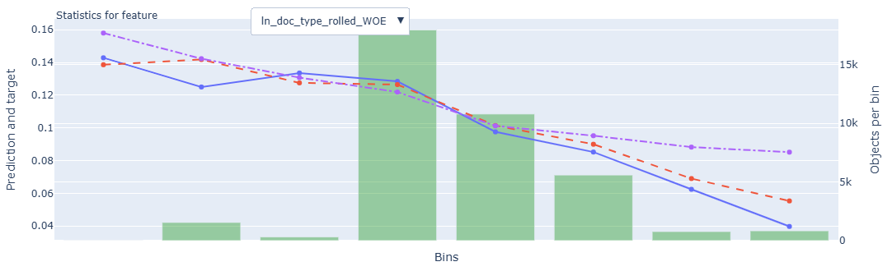
Rank# 2: ln_doc_type_rolled ( 2 / 5 ) - Feature Statistics Analysis <Disbursed>
The model is effectively using this feature, as the red prediction line closely follows the trend of the blue actual target line.
A clear and consistent gap between the red and purple lines across bins shows that the feature adds predictive power.
Green bars (record count per bin) show a right-skewed distribution, with most records concentrated in the middle-to-lower bins.
The target rate decreases steadily across bins, which aligns well with the WOE transformation, reinforcing this feature’s value in identifying low-risk profiles.
18

Slide 19
Rank# 2: ln_doc_type_rolled ( 3 / 5 ) - MoM Feature Distribution <Applied>
ln_doc_type_rolled | Applied Count | Approval Rate | national id | driving license | umid | passport | social security card | professional id card | postal id card | less_frequent_cat | missing |  | Avg. Demo Score
2024-08 | 25,136 | 60.0% | 40.9% | 29.1% | 18.3% | 5.9% | 2.4% | 1.6% | 1.6% | 0.0% | 0.0% |  | 0.49806503
2024-09 | 25,284 | 59.4% | 42.5% | 29.5% | 17.1% | 5.5% | 2.2% | 1.7% | 1.5% | 0.0% | 0.0% |  | 0.49974565
2024-10 | 23,980 | 58.9% | 43.0% | 30.0% | 16.3% | 5.2% | 2.4% | 1.7% | 1.3% | 0.0% | 0.0% |  | 0.49468015
2024-11 | 24,399 | 62.2% | 41.4% | 30.5% | 17.4% | 5.1% | 2.4% | 1.9% | 1.4% | 0.0% | 0.0% |  | 0.48374065
2024-12 | 48,407 | 59.4% | 46.3% | 28.5% | 15.9% | 4.2% | 2.3% | 1.8% | 0.9% | 0.0% | 0.0% |  | 0.48802628
2025-01 | 23,044 | 58.1% | 50.0% | 27.6% | 14.0% | 4.1% | 1.8% | 1.6% | 1.0% | 0.0% | 0.0% |  | 0.49425928
2025-02 | 20,636 | 59.0% | 51.4% | 26.8% | 13.4% | 4.3% | 1.8% | 1.4% | 0.8% | 0.0% | 0.0% |  | 0.49441829
2025-03 | 25,000 | 61.0% | 52.4% | 26.6% | 12.7% | 3.9% | 1.8% | 1.8% | 0.9% | 0.0% | 0.0% |  | 0.48966094
2025-04 | 26,389 | 62.3% | 50.8% | 27.5% | 13.0% | 4.5% | 1.5% | 1.8% | 0.9% | 0.0% | 0.0% |  | 0.48805174
2025-05 | 26,406 | 61.8% | 52.6% | 26.5% | 12.5% | 4.1% | 1.6% | 2.0% | 0.7% | 0.0% | 0.0% |  | 0.48956425
2025-06 | 22,903 | 65.3% | 49.4% | 28.0% | 13.5% | 4.7% | 1.7% | 2.0% | 0.7% | 0.0% | 0.0% |  | 0.48503991
2025-07 | 16,160 | 64.7% | 50.8% | 27.6% | 12.5% | 5.1% | 1.6% | 1.6% | 0.8% | 0.0% | 0.0% |  | 0.48868890
“National ID” consistently dominates, increasing steadily from 40.9% in Aug 2024 to 52.6% by May 2025 before settling around 50.8%, indicating stable document preference.
Other key document types like “Driving License”, “UMID”, and “Passport” remain within narrow bands, reinforcing predictable user submission behavior.
The “less frequent” and “missing” categories stay flat at 0%, confirming complete and clean data with no irregularities or anomalies.

Slide 20
Rank# 2: ln_doc_type_rolled ( 4 / 5 ) - MoM Feature Distribution <Applied> <User Type wise>
New Applicant
ln_doc_type_rolled | Applied Count | Approval Rate | national id | driving license | umid | passport | social security card | professional id card | postal id card | less_frequent_cat | missing |  | Avg. Demo Score
2024-08 | 24,489 | 59.7% | 41.1% | 29.1% | 18.2% | 5.9% | 2.4% | 1.7% | 1.6% | 0.0% | 0.0% |  | 0.50401733
2024-09 | 24,586 | 59.2% | 42.7% | 29.5% | 16.8% | 5.5% | 2.2% | 1.7% | 1.5% | 0.0% | 0.0% |  | 0.50623264
2024-10 | 23,174 | 58.5% | 43.4% | 30.0% | 16.1% | 5.2% | 2.3% | 1.7% | 1.3% | 0.0% | 0.0% |  | 0.50243876
2024-11 | 23,342 | 61.6% | 41.6% | 30.6% | 17.1% | 5.0% | 2.4% | 1.9% | 1.4% | 0.0% | 0.0% |  | 0.49347179
2024-12 | 46,925 | 59.3% | 46.6% | 28.4% | 15.8% | 4.2% | 2.3% | 1.8% | 0.9% | 0.0% | 0.0% |  | 0.49474936
2025-01 | 22,214 | 58.2% | 50.4% | 27.6% | 13.7% | 4.0% | 1.8% | 1.6% | 0.9% | 0.0% | 0.0% |  | 0.50244124
2025-02 | 19,736 | 59.2% | 51.9% | 26.7% | 13.2% | 4.2% | 1.8% | 1.4% | 0.8% | 0.0% | 0.0% |  | 0.50413760
2025-03 | 23,809 | 61.0% | 52.9% | 26.5% | 12.4% | 3.8% | 1.7% | 1.8% | 0.9% | 0.0% | 0.0% |  | 0.50027591
2025-04 | 25,098 | 62.1% | 51.3% | 27.4% | 12.8% | 4.4% | 1.5% | 1.9% | 0.8% | 0.0% | 0.0% |  | 0.49865757
2025-05 | 25,382 | 61.8% | 52.8% | 26.4% | 12.4% | 4.1% | 1.6% | 2.0% | 0.8% | 0.0% | 0.0% |  | 0.49802064
2025-06 | 21,852 | 65.3% | 49.6% | 28.0% | 13.3% | 4.7% | 1.7% | 2.0% | 0.7% | 0.0% | 0.0% |  | 0.49488959
2025-07 | 15,520 | 64.4% | 51.0% | 27.5% | 12.4% | 5.0% | 1.6% | 1.6% | 0.8% | 0.0% | 0.0% |  | 0.49704827
The “National ID” share grows from 41.1% to 52.9% between Aug 2024 and Mar 2025, then stabilizes, marking it as the dominant document choice among new users.
Supporting types such as “Driving License”, “UMID”, and “Passport” stay consistent month to month, showing minimal volatility.
Data remains fully captured across all months, with no missing, confirming high data integrity for this cohort.
Repeat Applicant
ln_doc_type_rolled | Applied Count | Approval Rate | national id | driving license | umid | passport | social security card | professional id card | postal id card | less_frequent_cat | missing |  | Avg. Demo Score
2024-08 | 647 | 71.9% | 34.2% | 28.4% | 25.2% | 6.2% | 2.3% | 1.2% | 2.5% | 0.0% | 0.0% |  | 0.27276985
2024-09 | 698 | 66.0% | 34.0% | 29.4% | 25.8% | 5.6% | 1.7% | 1.4% | 1.9% | 0.3% | 0.0% |  | 0.27125114
2024-10 | 806 | 70.0% | 33.9% | 30.5% | 21.2% | 5.3% | 3.0% | 3.0% | 2.9% | 0.2% | 0.0% |  | 0.27160578
2024-11 | 1,057 | 75.6% | 35.0% | 28.0% | 23.7% | 6.3% | 3.2% | 1.7% | 2.0% | 0.0% | 0.0% |  | 0.26884544
2024-12 | 1,482 | 60.7% | 39.1% | 29.1% | 20.3% | 5.3% | 3.0% | 1.3% | 1.7% | 0.1% | 0.0% |  | 0.27515154
2025-01 | 830 | 56.4% | 39.3% | 28.8% | 21.0% | 5.7% | 1.9% | 1.1% | 2.3% | 0.0% | 0.0% |  | 0.27527841
2025-02 | 900 | 55.1% | 40.7% | 28.7% | 18.2% | 6.2% | 2.9% | 2.1% | 1.2% | 0.0% | 0.0% |  | 0.28128463
2025-03 | 1,191 | 61.2% | 41.5% | 29.9% | 18.1% | 5.8% | 2.4% | 1.6% | 0.7% | 0.1% | 0.0% |  | 0.27745954
2025-04 | 1,291 | 65.4% | 41.0% | 30.7% | 17.3% | 5.6% | 2.3% | 1.5% | 1.6% | 0.0% | 0.0% |  | 0.28186643
2025-05 | 1,024 | 63.5% | 45.6% | 28.8% | 15.9% | 4.8% | 2.1% | 2.3% | 0.5% | 0.0% | 0.0% |  | 0.27995464
2025-06 | 1,051 | 66.7% | 44.8% | 28.6% | 17.2% | 5.3% | 1.5% | 1.7% | 0.8% | 0.0% | 0.0% |  | 0.28024897
2025-07 | 640 | 73.6% | 45.0% | 30.3% | 13.3% | 6.1% | 2.0% | 2.0% | 1.3% | 0.0% | 0.0% |  | 0.28031537
“National ID” use was lower initially (~34%) but grew steadily to 45% by Jul 2025, suggesting increasing compliance or preference among repeat users.
Despite higher variation in “UMID” and “Passport”, their shares converge gradually into stable ranges from Mar 2025 onwards.
The feature exhibits mild early variation but transitions into a stable pattern, confirming its suitability for modeling repeat applicants.
20

Slide 21
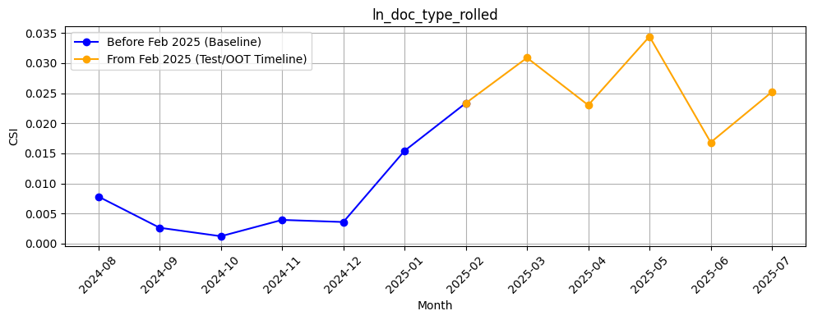
Rank# 2: ln_doc_type_rolled ( 5 / 5 ) - Feature CSI Analysis <Applied>
CSI during the baseline period (Aug 2024 to Jan 2025) stayed low, peaking just above 0.015 in Jan 2025 — indicating moderate but stable variation.
In the Test/OOT period (Feb to Jul 2025), CSI values showed mild volatility, fluctuating between ~0.017 and ~0.035.
Despite the fluctuations, all CSI values remained well below the 0.1 threshold, confirming no meaningful data drift.

Slide 22
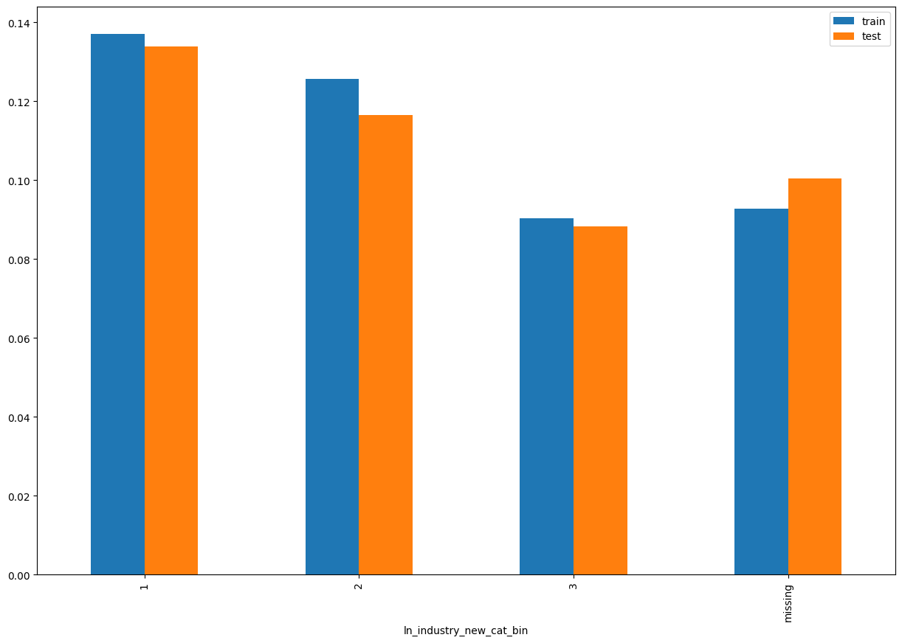
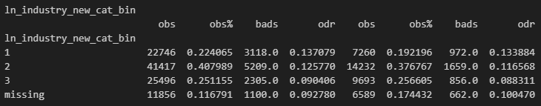
Rank# 3: ln_industry_new_cat_bin ( 1 / 5 ) - Feature Performance in Train vs Test <Disbursed>
Type of industry in which loan applicant is employed. Any industry that does not fall under the predefined categories is grouped into a new category called “New”
Bad_PCT | ln_industry_new_cat | Bin
Bad_PCT < 10 | 'accounting/bookkeeping/auditing', 'agribusiness/animal farming/fishing', 'architecture/engineering', 'banking', 'computer/it related services', 'education/private schools', 'govt. institution', 'hospital and medical services', 'insurance activities', 'legal service/law firm', 'manufacturing', 'ngos/nonprofit organization/foundation', 'pawnshop/remittance agent/virtual currency', 'religious organization', 'tourism, hotel and resorts' | 3
10 <= Bad_PCT < 13 | 'airline/aviation', 'business process outsourcing/tele marketing', "convenience store/internet cafe's", 'fin tech/financial services', 'freight and cargo', 'manpower/manning agencies', 'others', 'real estate', 'repair, sanitation and housekeeping', 'utilities (electricity, gas and water)', 'wholesale and retail trade' | 2
Bad_PCT >= 13 | 'advertising/sales/marketing', 'beauty and health services', 'construction', 'food industry/restaurants/fastfoods', 'fx dealer/money changer', 'gambling and betting (online gaming, lottery, casino)', 'gold/jewelry/precious metals/art/antique dealership', 'maritime/shipping', 'recreation (arts, entertainment/media, sports)', 'telecommunication', 'transportation' | 1
missing | Users with their source of funds as 'Remittance’, 'Pension’, 'Inheritance/Retirement Funds’, 'Interest on Deposits and Investments’, 'Allowance'

Slide 23
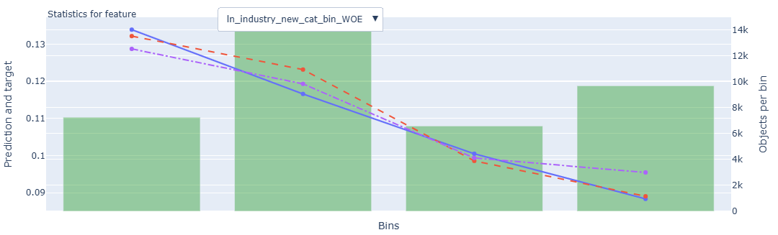
Rank# 3: ln_industry_new_cat_bin ( 2 / 5 ) - Feature Statistics Analysis <Disbursed>
The red line (model prediction) follows the trend of the blue line (actual target) closely, indicating the model is effectively learning from this feature.
A consistent gap between the red and purple lines across bins signifies that this categorical feature contributes positively to model accuracy.
The green bars show a moderately balanced distribution across bins, with slight concentration in the middle and higher bins—indicating no significant skewness.
The target rate steadily decreases across bins, aligning with WOE transformation logic. This consistent pattern highlights the feature's strong discriminatory power in separating low-risk and high-risk groups.
23

Slide 24
Rank# 3: ln_industry_new_cat_bin ( 3 / 5 ) - MoM Feature Distribution <Applied>
ln_industry_new_cat_bin | Applied Count | Approval Rate | 2 | 1 | 3 | missing | new |  | Avg. Demo Score
2024-08 | 25,136 | 60.0% | 41.3% | 25.1% | 21.4% | 12.3% | 0.0% |  | 0.49806503
2024-09 | 25,284 | 59.4% | 41.9% | 25.1% | 21.6% | 11.3% | 0.0% |  | 0.49974565
2024-10 | 23,980 | 58.9% | 41.9% | 24.5% | 21.6% | 11.9% | 0.0% |  | 0.49468015
2024-11 | 24,399 | 62.2% | 41.8% | 23.3% | 22.7% | 12.2% | 0.0% |  | 0.48374065
2024-12 | 48,407 | 59.4% | 40.7% | 23.5% | 24.8% | 11.0% | 0.0% |  | 0.48802628
2025-01 | 23,044 | 58.1% | 41.3% | 23.0% | 22.1% | 13.6% | 0.0% |  | 0.49425928
2025-02 | 20,636 | 59.0% | 41.1% | 22.0% | 22.0% | 15.0% | 0.0% |  | 0.49441829
2025-03 | 25,000 | 61.0% | 39.7% | 21.2% | 22.3% | 16.9% | 0.0% |  | 0.48966094
2025-04 | 26,389 | 62.3% | 38.0% | 21.5% | 22.8% | 17.7% | 0.0% |  | 0.48805174
2025-05 | 26,406 | 61.8% | 35.7% | 23.9% | 24.5% | 15.7% | 0.3% |  | 0.48956425
2025-06 | 22,903 | 65.3% | 36.5% | 24.7% | 23.8% | 14.2% | 0.8% |  | 0.48503991
2025-07 | 16,160 | 64.7% | 35.7% | 26.0% | 22.5% | 14.9% | 0.8% |  | 0.48868890
Category 2 shows a consistent decline from 41.9% to 35.7% over time, while categories 1 and 3 rise gradually, reflecting a smooth and controlled shift in user mix.
The “missing” share peaks at 17.7% in Apr 2025 but trends down to 14.9%, while “new” values are introduced in May and stabilize around 0.8%.
The transitions are steady with no spikes or noise, confirming this feature’s suitability for modeling and low-risk integration.
24

Slide 25
Rank# 3: ln_industry_new_cat_bin ( 4 / 5 ) - MoM Feature Distribution <Applied> <User Type wise>
New Applicant
ln_industry_new_cat_bin | Applied Count | Approval Rate | 2 | 1 | 3 | missing | new |  | Avg. Demo Score
2024-08 | 24,489 | 59.7% | 41.5% | 25.2% | 21.3% | 11.9% | 0.0% |  | 0.50401733
2024-09 | 24,586 | 59.2% | 42.2% | 25.3% | 21.5% | 11.0% | 0.0% |  | 0.50623264
2024-10 | 23,174 | 58.5% | 42.1% | 24.8% | 21.6% | 11.6% | 0.0% |  | 0.50243876
2024-11 | 23,342 | 61.6% | 42.0% | 23.5% | 22.6% | 11.8% | 0.0% |  | 0.49347179
2024-12 | 46,925 | 59.3% | 40.7% | 23.6% | 24.9% | 10.8% | 0.0% |  | 0.49474936
2025-01 | 22,214 | 58.2% | 41.4% | 23.1% | 22.2% | 13.3% | 0.0% |  | 0.50244124
2025-02 | 19,736 | 59.2% | 41.1% | 22.0% | 22.1% | 14.8% | 0.0% |  | 0.50413760
2025-03 | 23,809 | 61.0% | 39.8% | 21.2% | 22.1% | 16.8% | 0.0% |  | 0.50027591
2025-04 | 25,098 | 62.1% | 38.1% | 21.4% | 22.8% | 17.7% | 0.0% |  | 0.49865757
2025-05 | 25,382 | 61.8% | 35.6% | 24.0% | 24.3% | 15.8% | 0.3% |  | 0.49802064
2025-06 | 21,852 | 65.3% | 36.2% | 24.9% | 23.8% | 14.3% | 0.8% |  | 0.49488959
2025-07 | 15,520 | 64.4% | 35.6% | 26.1% | 22.6% | 14.9% | 0.8% |  | 0.49704827
Category 2 steadily declines from 42.2% in Sep 2024 to 35.6% in Jul 2025, while category 1 increases, reaching 26.1%, reflecting a balanced profile shift.
“Missing” values rise until Apr 2025 and then improve, while “new” values appear from May, reaching 0.8%, showing controlled enrichment.
The feature displays stable behavior month to month, with no irregularities, making it reliable for new applicant segmentation.
Repeat Applicant
ln_industry_new_cat_bin | Applied Count | Approval Rate | 2 | 3 | 1 | missing | new |  | Avg. Demo Score
2024-08 | 647 | 71.9% | 31.2% | 22.4% | 17.6% | 28.7% | 0.0% |  | 0.27276985
2024-09 | 698 | 66.0% | 30.8% | 27.4% | 19.5% | 22.3% | 0.0% |  | 0.27125114
2024-10 | 806 | 70.0% | 37.0% | 23.9% | 18.5% | 20.6% | 0.0% |  | 0.27160578
2024-11 | 1,057 | 75.6% | 36.0% | 24.7% | 18.1% | 21.3% | 0.0% |  | 0.26884544
2024-12 | 1,482 | 60.7% | 39.5% | 23.1% | 20.1% | 17.3% | 0.0% |  | 0.27515154
2025-01 | 830 | 56.4% | 38.1% | 18.3% | 21.9% | 21.7% | 0.0% |  | 0.27527841
2025-02 | 900 | 55.1% | 40.2% | 20.0% | 22.0% | 17.8% | 0.0% |  | 0.28128463
2025-03 | 1,191 | 61.2% | 37.1% | 24.4% | 20.7% | 17.8% | 0.0% |  | 0.27745954
2025-04 | 1,291 | 65.4% | 35.8% | 23.3% | 23.5% | 17.4% | 0.0% |  | 0.28186643
2025-05 | 1,024 | 63.5% | 37.6% | 27.5% | 21.3% | 13.5% | 0.1% |  | 0.27995464
2025-06 | 1,051 | 66.7% | 42.5% | 24.2% | 20.6% | 12.4% | 0.4% |  | 0.28024897
2025-07 | 640 | 73.6% | 39.5% | 21.6% | 25.0% | 13.0% | 0.9% |  | 0.28031537
Category 2 rises from 31.2% to 42.5% over time, indicating growing alignment with a dominant industry classification among repeat applicants.
“Missing” data steadily declines from 28.7% to 13.0%, while “new” values are introduced cleanly post-May, reaching 0.9% without noise.
The distribution shifts gradually, with predictable movement across all classes, confirming robust feature behavior for repeat-user modeling.
25

Slide 26
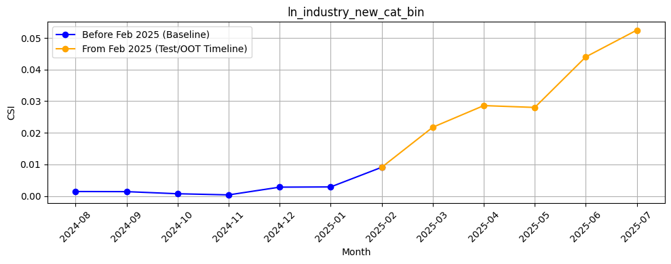
Rank# 3: ln_industry_new_cat_bin ( 5 / 5 ) - Feature CSI Analysis <Applied>
CSI values during the baseline period (Aug 2024 to Jan 2025) were extremely low, indicating excellent feature stability.
A steady increase was observed during the Test/OOT period (Feb to Jul 2025), with CSI rising from ~0.009 to ~0.053.
Despite the upward trend, all values remained well below the 0.1 threshold — confirming no significant data drift.
26

Slide 27
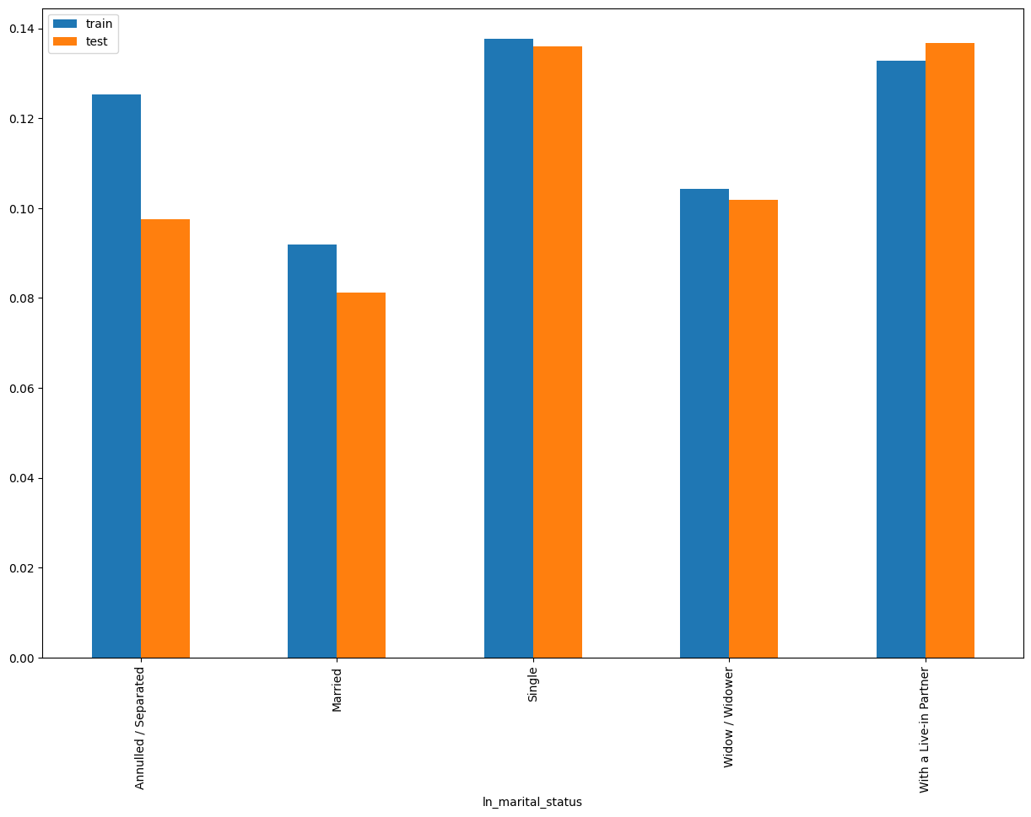
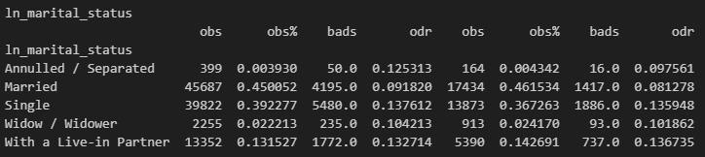
Rank# 4: ln_marital_status ( 1 / 5 ) - Feature Performance in Train vs Test <Disbursed>
It indicates the marital status of the loan applicant.

Slide 28
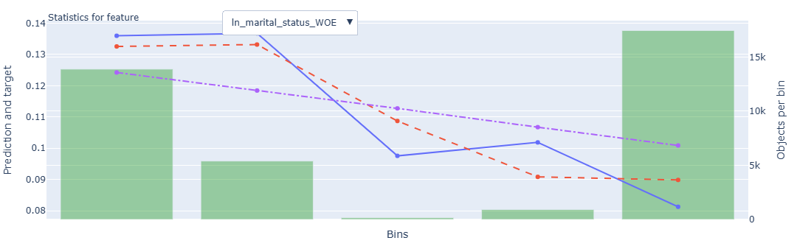
Rank# 4: ln_marital_status ( 2 / 5 ) - Feature Statistics Analysis <Disbursed>
The model is leveraging this categorical feature well, as seen by the red prediction line generally mirroring the actual blue target line.
A noticeable and consistent separation between the red and purple lines suggests this feature adds meaningful value to prediction quality.
The green bars reveal a left-skewed distribution—majority of records are in the rightmost bin—implying certain marital statuses are more prevalent in the population.
The target rate drops across bins, which conforms with the WOE logic and underscores this feature’s contribution to risk differentiation.
28

Slide 29
Rank# 4: ln_marital_status ( 3 / 5 ) - MoM Feature Distribution <Applied>
ln_marital_status | Applied Count | Approval Rate | Married | Single | With a Live-in Partner | Widow / Widower | Annulled / Separated |  | Avg. Demo Score
2024-08 | 25,136 | 60.0% | 40.1% | 46.4% | 11.4% | 1.8% | 0.4% |  | 0.49806503
2024-09 | 25,284 | 59.4% | 39.7% | 46.2% | 11.6% | 2.1% | 0.4% |  | 0.49974565
2024-10 | 23,980 | 58.9% | 41.1% | 43.8% | 12.5% | 2.1% | 0.4% |  | 0.49468015
2024-11 | 24,399 | 62.2% | 43.0% | 40.6% | 13.9% | 2.2% | 0.4% |  | 0.48374065
2024-12 | 48,407 | 59.4% | 42.7% | 40.3% | 14.7% | 2.0% | 0.3% |  | 0.48802628
2025-01 | 23,044 | 58.1% | 42.5% | 38.9% | 16.3% | 2.0% | 0.3% |  | 0.49425928
2025-02 | 20,636 | 59.0% | 42.0% | 39.9% | 15.6% | 2.1% | 0.4% |  | 0.49441829
2025-03 | 25,000 | 61.0% | 42.5% | 39.3% | 15.5% | 2.4% | 0.3% |  | 0.48966094
2025-04 | 26,389 | 62.3% | 42.0% | 39.4% | 16.2% | 2.0% | 0.4% |  | 0.48805174
2025-05 | 26,406 | 61.8% | 43.3% | 37.7% | 16.5% | 2.2% | 0.4% |  | 0.48956425
2025-06 | 22,903 | 65.3% | 43.1% | 37.8% | 16.6% | 2.2% | 0.4% |  | 0.48503991
2025-07 | 16,160 | 64.7% | 43.0% | 38.3% | 16.1% | 2.4% | 0.3% |  | 0.48868890
The “Single” group shows a gradual decline from 46.4% to 38.3%, while the “Married” category rises from 40.1% to 43.3%, reflecting a subtle but consistent profile shift.
“With a Live-in Partner” increases from 11.4% to 16.6% over the months, indicating slow and steady growth in alternate household types.
Rare categories like “Widow/Widower” and “Annulled/Separated” remain under 2.5% and 0.4% respectively, ensuring stable low-frequency behavior throughout.
29

Slide 30
Rank# 4: ln_marital_status ( 4 / 5 ) - MoM Feature Distribution <Applied> <User Type wise>
New Applicant
ln_marital_status | Applied Count | Approval Rate | Married | Single | With a Live-in Partner | Widow / Widower | Annulled / Separated |  | Avg. Demo Score
2024-08 | 24,489 | 59.7% | 40.0% | 46.5% | 11.3% | 1.8% | 0.4% |  | 0.50401733
2024-09 | 24,586 | 59.2% | 39.6% | 46.3% | 11.6% | 2.1% | 0.4% |  | 0.50623264
2024-10 | 23,174 | 58.5% | 41.2% | 43.9% | 12.4% | 2.1% | 0.5% |  | 0.50243876
2024-11 | 23,342 | 61.6% | 43.0% | 40.6% | 13.9% | 2.2% | 0.4% |  | 0.49347179
2024-12 | 46,925 | 59.3% | 42.7% | 40.3% | 14.6% | 2.1% | 0.3% |  | 0.49474936
2025-01 | 22,214 | 58.2% | 42.5% | 38.9% | 16.3% | 2.0% | 0.3% |  | 0.50244124
2025-02 | 19,736 | 59.2% | 41.9% | 40.0% | 15.6% | 2.1% | 0.4% |  | 0.50413760
2025-03 | 23,809 | 61.0% | 42.4% | 39.4% | 15.5% | 2.4% | 0.3% |  | 0.50027591
2025-04 | 25,098 | 62.1% | 41.8% | 39.5% | 16.2% | 2.1% | 0.3% |  | 0.49865757
2025-05 | 25,382 | 61.8% | 43.3% | 37.7% | 16.4% | 2.2% | 0.4% |  | 0.49802064
2025-06 | 21,852 | 65.3% | 43.0% | 37.8% | 16.6% | 2.2% | 0.4% |  | 0.49488959
2025-07 | 15,520 | 64.4% | 42.9% | 38.4% | 16.2% | 2.3% | 0.2% |  | 0.49704827
The “Single” share gradually decreases from 46.5% in Aug 2024 to 38.4% by Jul 2025, while “Married” rises from 40.0% to 42.9%, suggesting a steady shift in demographic mix.
“With a Live-in Partner” increases consistently from 11.3% to 16.6%, indicating growing adoption of alternate relationship categories over time.
Low-frequency classes like “Widow/Widower” and “Annulled/Separated” remain well-contained under 2.5% and 0.5% respectively, ensuring category-level distributional stability.
Repeat Applicant
ln_marital_status | Applied Count | Approval Rate | Married | Single | With a Live-in Partner | Widow / Widower | Annulled / Separated |  | Avg. Demo Score
2024-08 | 647 | 71.9% | 41.7% | 41.7% | 14.8% | 1.5% | 0.2% |  | 0.27276985
2024-09 | 698 | 66.0% | 43.8% | 40.8% | 13.0% | 1.9% | 0.4% |  | 0.27125114
2024-10 | 806 | 70.0% | 39.8% | 41.6% | 15.9% | 2.7% | 0.0% |  | 0.27160578
2024-11 | 1,057 | 75.6% | 43.7% | 40.4% | 13.7% | 1.9% | 0.3% |  | 0.26884544
2024-12 | 1,482 | 60.7% | 41.3% | 40.2% | 16.5% | 1.8% | 0.2% |  | 0.27515154
2025-01 | 830 | 56.4% | 42.2% | 39.6% | 16.1% | 1.9% | 0.1% |  | 0.27527841
2025-02 | 900 | 55.1% | 43.6% | 39.4% | 14.4% | 2.1% | 0.4% |  | 0.28128463
2025-03 | 1,191 | 61.2% | 45.3% | 36.7% | 14.9% | 2.5% | 0.6% |  | 0.27745954
2025-04 | 1,291 | 65.4% | 45.5% | 37.5% | 15.1% | 1.4% | 0.5% |  | 0.28186643
2025-05 | 1,024 | 63.5% | 43.8% | 36.2% | 17.5% | 2.1% | 0.3% |  | 0.27995464
2025-06 | 1,051 | 66.7% | 44.9% | 37.4% | 15.1% | 2.4% | 0.2% |  | 0.28024897
2025-07 | 640 | 73.6% | 45.2% | 36.6% | 14.2% | 3.6% | 0.5% |  | 0.28031537
The “Married” group steadily increases from 41.7% to 45.2%, while the “Single” category declines from 41.7% to 36.6%, showing a clear rebalancing trend.
“Live-in Partner” fluctuates slightly but stabilizes above 14%, while “Widow/Widower” sees a minor rise, peaking at 3.6% in Jul 2025.
Rare categories stay below 1%, with “Annulled/Separated” consistently low and well-distributed, confirming modeling reliability and consistency.
30

Slide 31
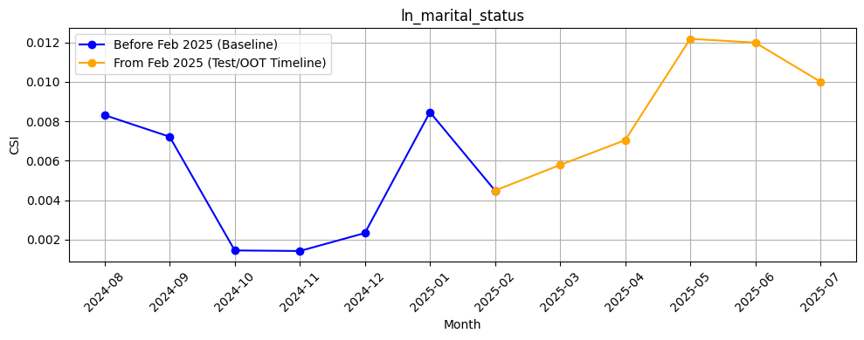
Rank# 4: ln_marital_status ( 5 / 5 ) - Feature CSI Analysis <Applied>
During the baseline period (Aug 2024 to Jan 2025), CSI values remained low and stable, all under 0.009.
A gradual increase was seen in the Test/OOT period (Feb to Jul 2025), peaking at ~0.012 in May and June.
All CSI values remained well below the 0.1 threshold, indicating no significant data drift over time.
31

Slide 32
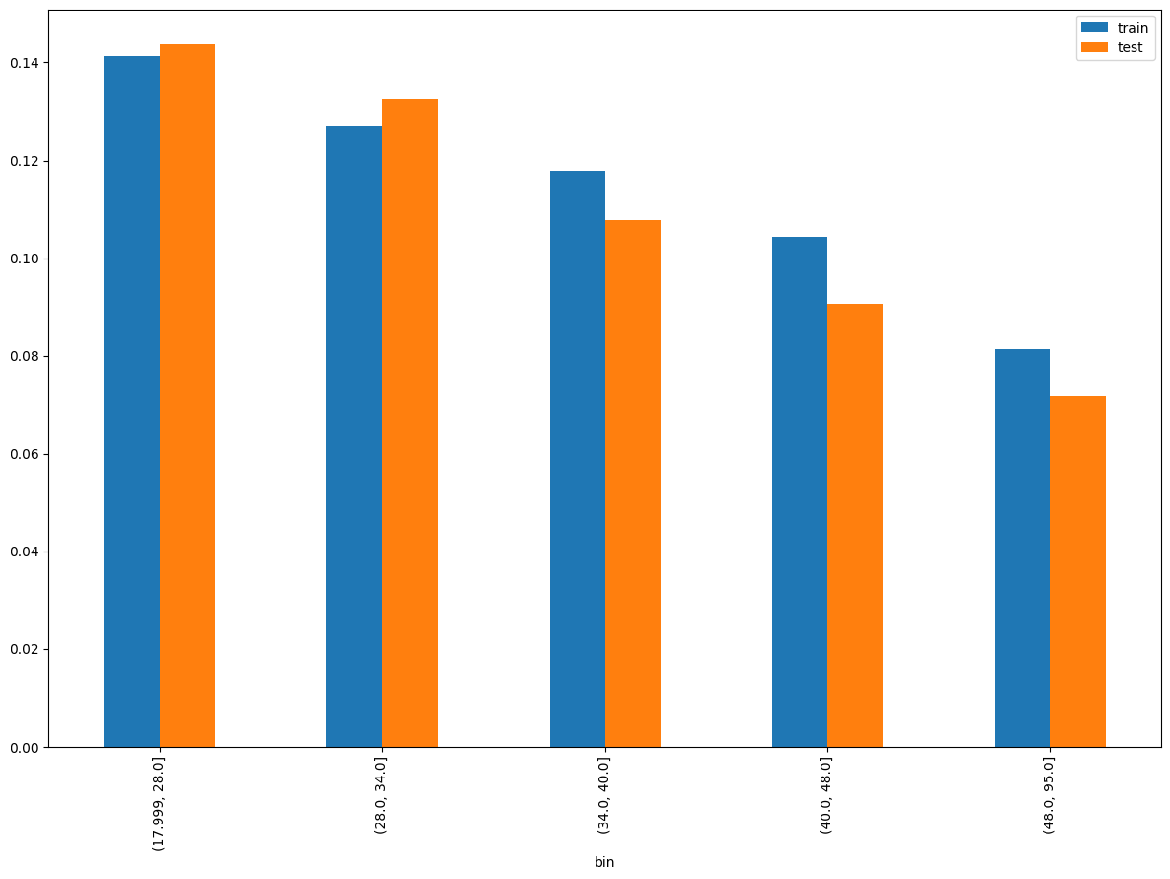
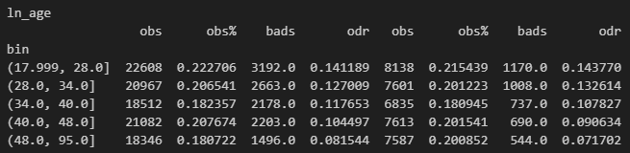
Rank# 5: ln_age ( 1 / 6 ) - Feature Performance in Train vs Test <Disbursed>
Age of the loan applicant/customer
32
Please note these are just WOE Bins, NOT the final Bins that Catboost chooses internally

Slide 33
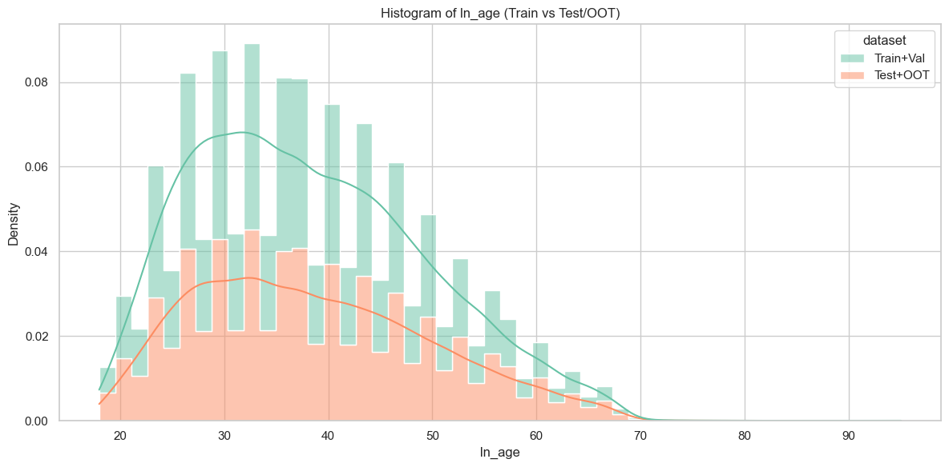
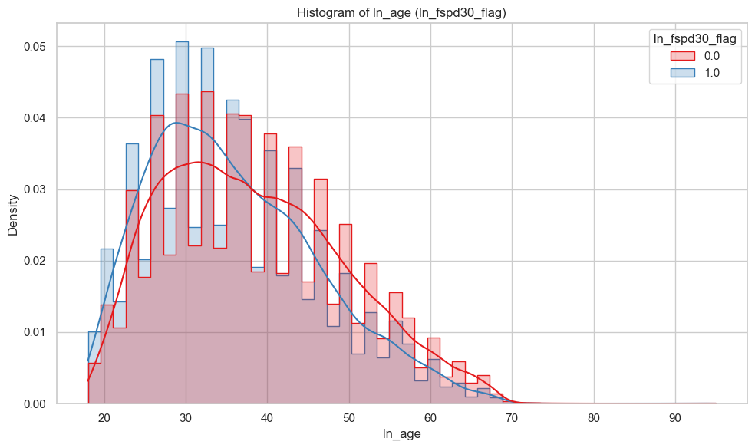
Rank# 5: ln_age ( 2 / 6 ) - Histogram <Disbursed>
Most customers, both good and bad, are in their late 20s to early 30s, with similar overall age distributions. However, bad customers (blue line) tend to be slightly younger on average, while good customers (red line) are more common in older age groups.
The Train+Validation set (green) has a higher concentration of younger customers, especially around the late 20s to early 30s. The Test+OOT set (orange) follows a similar pattern but with lower density across all ages, indicating fewer samples and slightly older age distribution.

Slide 34
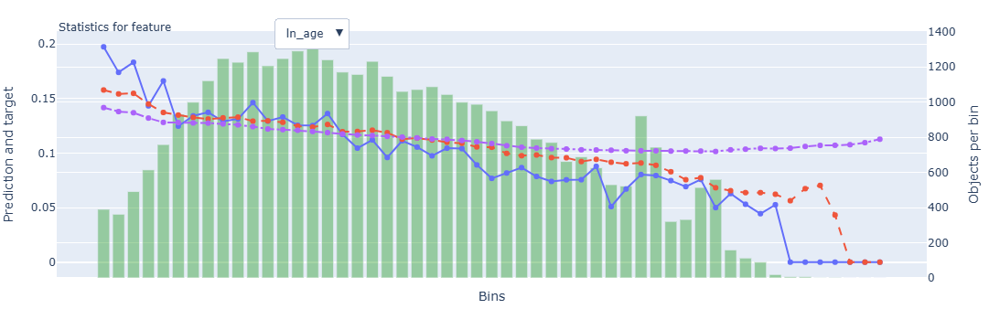
Rank# 5: ln_age ( 3 / 6 ) - Feature Statistics Analysis <Disbursed>
The red prediction line tracks the actual target (blue) trend fairly well, showing that the model is utilizing age as a numerical predictor effectively.
The gap between the red and purple lines is consistent, highlighting the predictive contribution of this feature.
The green bars (sample distribution) are well spread across age bins, peaking in the middle age range, suggesting a normal-like distribution.
The target rate shows a clear downward trend with increasing age, implying younger applicants are more likely to fall into the not-disbursed category—making this a strong signal feature for the model.

Slide 35
Rank# 5: ln_age ( 4 / 6 ) - MoM Mean Distribution <Applied>
ln_age | Applied Count | Approval Rate | Mean |  | Avg. Demo Score
2024-08 | 25,136 | 60.0% | 36.55 |  | 0.49806503
2024-09 | 25,284 | 59.4% | 36.67 |  | 0.49974565
2024-10 | 23,980 | 58.9% | 36.96 |  | 0.49468015
2024-11 | 24,399 | 62.2% | 37.55 |  | 0.48374065
2024-12 | 48,407 | 59.4% | 37.50 |  | 0.48802628
2025-01 | 23,044 | 58.1% | 37.26 |  | 0.49425928
2025-02 | 20,636 | 59.0% | 37.50 |  | 0.49441829
2025-03 | 25,000 | 61.0% | 37.60 |  | 0.48966094
2025-04 | 26,389 | 62.3% | 37.33 |  | 0.48805174
2025-05 | 26,406 | 61.8% | 37.50 |  | 0.48956425
2025-06 | 22,903 | 65.3% | 37.58 |  | 0.48503991
2025-07 | 16,160 | 64.7% | 37.71 |  | 0.48868890
The mean age remains highly stable, ranging between 36.5 and 37.7 across months, with a gradual upward drift toward the later periods.
A brief dip in Jan 2025 (~37.26) is observed, but values recover smoothly, indicating no sustained shift or data quality concerns.
Overall, the trend is clean and consistent with no spikes or volatility, validating this feature’s reliability for model usage.
35

Slide 36
Rank# 5: ln_age ( 5 / 6 ) - MoM Mean Distribution <Applied> <User Type wise>
New Applicant
ln_age | Applied Count | Approval Rate | Mean |  | Avg. Demo Score
2024-08 | 24,489 | 59.7% | 36.54 |  | 0.50401733
2024-09 | 24,586 | 59.2% | 36.64 |  | 0.50623264
2024-10 | 23,174 | 58.5% | 36.93 |  | 0.50243876
2024-11 | 23,342 | 61.6% | 37.56 |  | 0.49347179
2024-12 | 46,925 | 59.3% | 37.50 |  | 0.49474936
2025-01 | 22,214 | 58.2% | 37.25 |  | 0.50244124
2025-02 | 19,736 | 59.2% | 37.47 |  | 0.50413760
2025-03 | 23,809 | 61.0% | 37.58 |  | 0.50027591
2025-04 | 25,098 | 62.1% | 37.29 |  | 0.49865757
2025-05 | 25,382 | 61.8% | 37.47 |  | 0.49802064
2025-06 | 21,852 | 65.3% | 37.54 |  | 0.49488959
2025-07 | 15,520 | 64.4% | 37.66 |  | 0.49704827
Repeat Applicant
ln_age | Applied Count | Approval Rate | Mean |  | Avg. Demo Score
2024-08 | 647 | 71.9% | 36.83 |  | 0.27276985
2024-09 | 698 | 66.0% | 37.56 |  | 0.27125114
2024-10 | 806 | 70.0% | 37.72 |  | 0.27160578
2024-11 | 1,057 | 75.6% | 37.35 |  | 0.26884544
2024-12 | 1,482 | 60.7% | 37.59 |  | 0.27515154
2025-01 | 830 | 56.4% | 37.65 |  | 0.27527841
2025-02 | 900 | 55.1% | 38.11 |  | 0.28128463
2025-03 | 1,191 | 61.2% | 38.03 |  | 0.27745954
2025-04 | 1,291 | 65.4% | 38.22 |  | 0.28186643
2025-05 | 1,024 | 63.5% | 38.37 |  | 0.27995464
2025-06 | 1,051 | 66.7% | 38.44 |  | 0.28024897
2025-07 | 640 | 73.6% | 38.86 |  | 0.28031537
Mean age for new applicants moves steadily upward from 36.5 in Aug 2024 to 37.7 in Jul 2025, showing a smooth, linear progression.
No sudden changes are observed; even the slight drop in Jan (37.25) quickly normalizes, supporting stable user demographics.
The feature exhibits clear month-on-month consistency, making it robust and dependable for modeling new user behavior.
Repeat applicants show a continuous rise in mean age from 36.8 to 38.9, with no backward fluctuations, indicating clear demographic aging.
Month-over-month growth is smooth and uninterrupted, suggesting a naturally evolving user base with minimal data disruptions.
The feature maintains clean, predictable behavior and is highly reliable for longitudinal modeling in returning applicant cohorts.
36

Slide 37
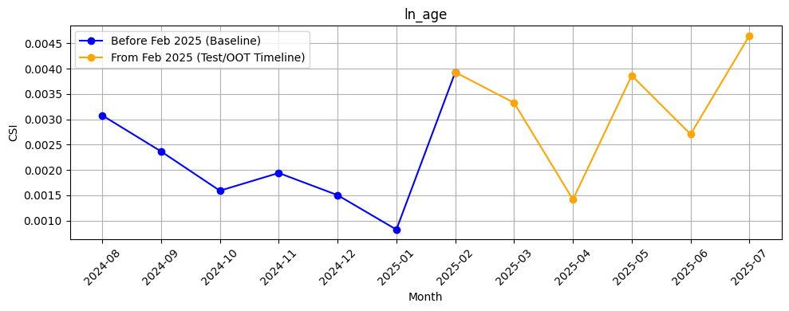
Rank# 5: ln_age ( 6 / 6 ) - Feature CSI Analysis <Applied>
CSI values during the baseline period (Aug 2024 to Jan 2025) were consistently low, all under 0.0031.
Moderate fluctuations were seen in the Test/OOT period (Feb to Jul 2025), peaking at ~0.0046 in Jul 2025.
CSI values remained well below the 0.1 threshold throughout, confirming stable feature behavior with no data drift.

Slide 38
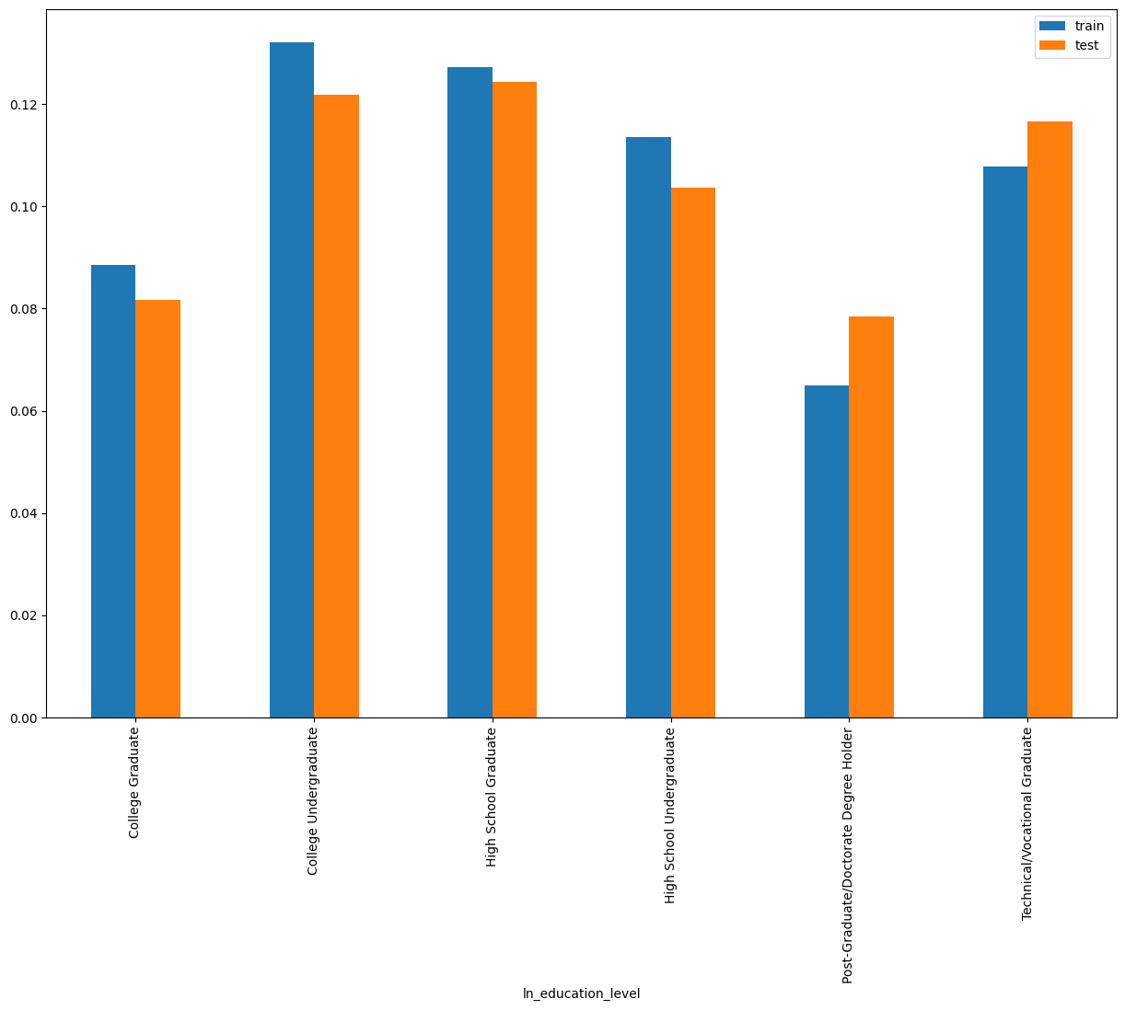
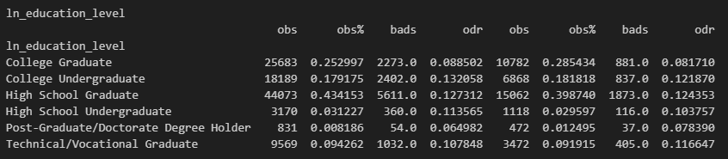
Rank# 6: ln_education_level ( 1 / 4 ) - Feature Performance in Train vs Test <Disbursed>
Highest Education Level of loan applicant.

Slide 39
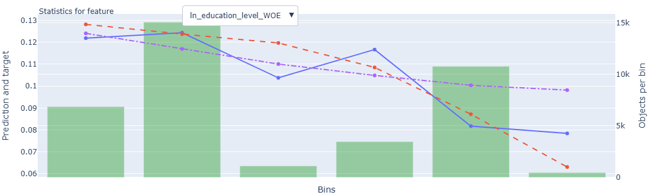
Rank# 6: ln_education_level ( 2 / 4 ) - Feature Statistics Analysis <Disbursed>
The model is using this feature well, as the red prediction line mostly follows the trend of the blue target line.
The consistent vertical gap between red and purple lines confirms the feature’s contribution to predictive power.
Green bars show a mild skew, with records peaking in the second bin.
The target rate decreases as WOE values increase, indicating that higher education levels are associated with lower default risk, a valuable input for the model.
39

Slide 40
Rank# 6: ln_education_level ( 3 / 4 ) - MoM Feature Distribution <Applied>
ln_education_level | Applied Count | Approval Rate | High School Graduate | College Graduate | College Undergraduate | Technical/Vocational Graduate | High School Undergraduate | Post-Graduate/Doctorate Degree Holder |  | Avg. Demo Score
2024-08 | 25,136 | 60.0% | 42.64% | 24.40% | 20.16% | 9.01% | 3.23% | 0.56% |  | 0.49806503
2024-09 | 25,284 | 59.4% | 43.46% | 23.62% | 19.72% | 9.38% | 3.28% | 0.54% |  | 0.49974565
2024-10 | 23,980 | 58.9% | 43.80% | 23.59% | 19.21% | 9.82% | 3.02% | 0.57% |  | 0.49468015
2024-11 | 24,399 | 62.2% | 44.01% | 24.37% | 18.51% | 9.29% | 3.09% | 0.73% |  | 0.48374065
2024-12 | 48,407 | 59.4% | 44.91% | 24.02% | 17.69% | 9.50% | 3.16% | 0.72% |  | 0.48802628
2025-01 | 23,044 | 58.1% | 43.38% | 23.76% | 19.09% | 9.65% | 3.36% | 0.75% |  | 0.49425928
2025-02 | 20,636 | 59.0% | 42.75% | 24.58% | 18.84% | 9.49% | 3.48% | 0.87% |  | 0.49441829
2025-03 | 25,000 | 61.0% | 42.88% | 25.10% | 18.44% | 9.57% | 3.14% | 0.88% |  | 0.48966094
2025-04 | 26,389 | 62.3% | 41.42% | 26.84% | 18.78% | 9.16% | 2.71% | 1.09% |  | 0.48805174
2025-05 | 26,406 | 61.8% | 42.26% | 26.01% | 18.41% | 9.40% | 2.91% | 1.01% |  | 0.48956425
2025-06 | 22,903 | 65.3% | 42.65% | 25.28% | 18.51% | 9.62% | 3.02% | 0.92% |  | 0.48503991
2025-07 | 16,160 | 64.7% | 43.66% | 25.18% | 17.94% | 9.31% | 3.16% | 0.76% |  | 0.48868890
"High School Graduate" remains the dominant category, hovering between 42% and 45%, with minor fluctuations indicating a stable educational profile.
"College Graduate" shows a gradual rise from 23.6% to 26.8% by Apr 2025 before leveling off, while other groups remain within narrow and stable bands.
Rare categories like “Post-Graduate” and “High School Undergraduate” stay consistently under 4%, ensuring low volatility and clean distribution over time.

Slide 41
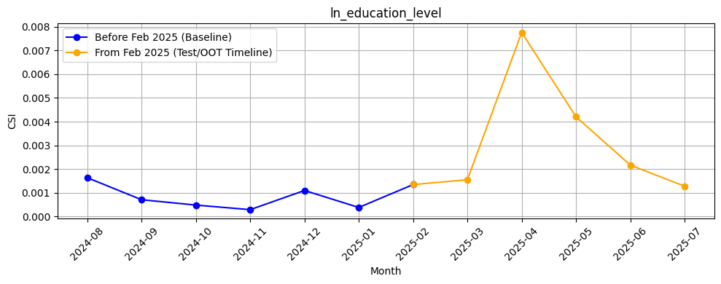
Rank# 6: ln_education_level ( 4 / 4 ) - Feature CSI Analysis <Applied>
CSI remained very low during the baseline period (Aug 2024 to Jan 2025), consistently under 0.0015.
A noticeable spike occurred in Apr 2025 (~0.0078) during the Test/OOT period, followed by a steady decline.
All values stayed far below the 0.1 threshold, indicating no meaningful data drift across the timeline.

Slide 42
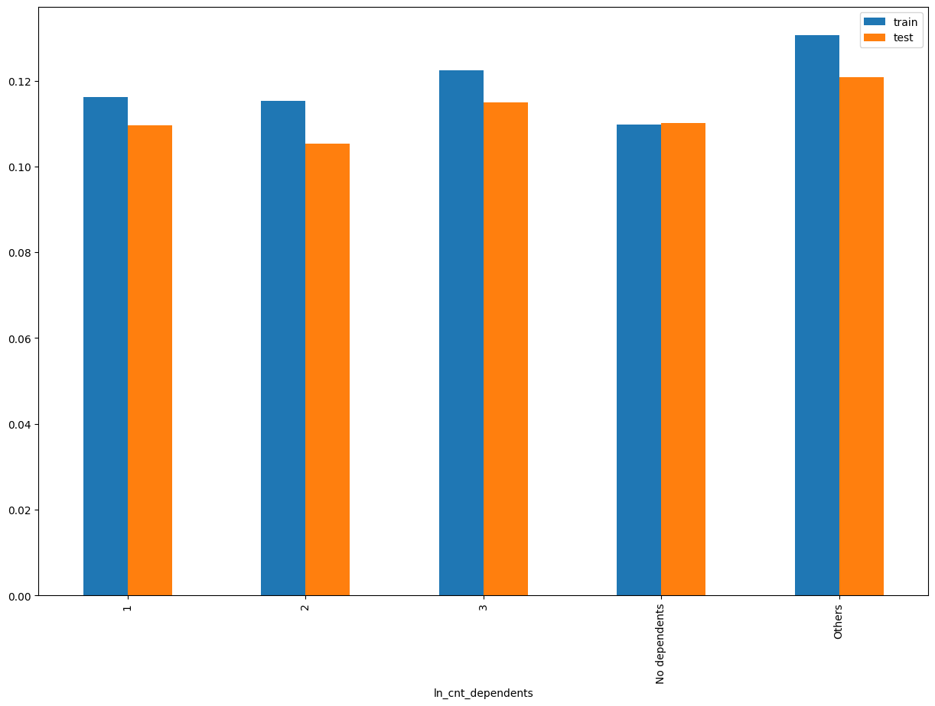
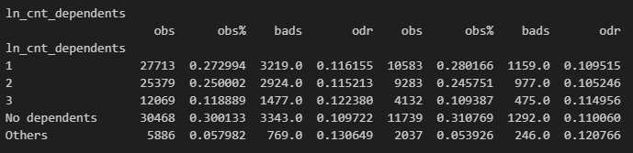
Rank# 7: ln_cnt_dependents ( 1 / 4 ) - Feature Performance in Train vs Test <Disbursed>
This feature represents the number of financial dependents reported by the applicant, grouped into distinct categories including 'No dependents', 1, 2, 3, and Others.
Others
'4’, '5 or more'

Slide 43
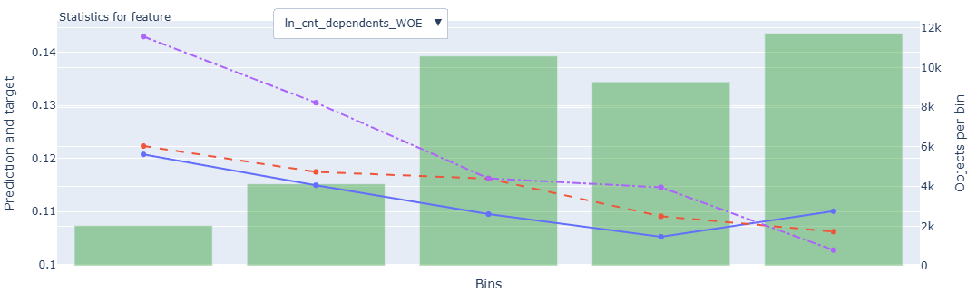
Rank# 7: ln_cnt_dependents ( 2 / 4 ) - Feature Statistics Analysis <Disbursed>
The red prediction line follows the blue target line with good alignment, indicating effective use of this feature by the model.
The vertical distance from red to purple lines implies this feature enhances predictive performance.
Green bars show a right-skewed distribution, with more samples concentrated in the higher WOE bins.
A downward trend in target rate with increasing WOE indicates more dependents may correlate with higher risk — a useful discriminator for the model.
43

Slide 44
Rank# 7: ln_cnt_dependents ( 3 / 4 ) - MoM Feature Distribution <Applied>
ln_cnt_dependents | Applied Count | Approval Rate | No dependents | 1 | 2 | 3 | Others |  | Avg. Demo Score
2024-08 | 25,136 | 60.0% | 32.2% | 26.6% | 23.9% | 11.7% | 5.7% |  | 0.49806503
2024-09 | 25,284 | 59.4% | 32.6% | 26.6% | 23.3% | 11.6% | 6.0% |  | 0.49974565
2024-10 | 23,980 | 58.9% | 32.0% | 27.0% | 23.9% | 11.3% | 6.0% |  | 0.49468015
2024-11 | 24,399 | 62.2% | 30.5% | 27.1% | 24.8% | 11.6% | 6.0% |  | 0.48374065
2024-12 | 48,407 | 59.4% | 30.9% | 26.9% | 24.5% | 11.8% | 5.8% |  | 0.48802628
2025-01 | 23,044 | 58.1% | 29.5% | 27.8% | 25.0% | 11.7% | 5.9% |  | 0.49425928
2025-02 | 20,636 | 59.0% | 30.9% | 27.7% | 24.5% | 11.2% | 5.7% |  | 0.49441829
2025-03 | 25,000 | 61.0% | 31.4% | 27.9% | 24.5% | 10.9% | 5.4% |  | 0.48966094
2025-04 | 26,389 | 62.3% | 32.8% | 28.1% | 23.7% | 10.6% | 4.7% |  | 0.48805174
2025-05 | 26,406 | 61.8% | 31.2% | 28.5% | 24.1% | 11.0% | 5.3% |  | 0.48956425
2025-06 | 22,903 | 65.3% | 31.3% | 27.9% | 24.4% | 11.0% | 5.4% |  | 0.48503991
2025-07 | 16,160 | 64.7% | 31.1% | 27.6% | 24.4% | 11.3% | 5.6% |  | 0.48868890
"No dependents" remains the largest group, fluctuating modestly between 29.5% and 32.8%, with no outliers across months.
Dependent counts from 1 to 3 remain stable, showing smooth shifts with category shares moving within tight 1–2% bands over time.
The “Others” group stays minimal and steady, confirming the feature's consistency and suitability for modeling without needing category rebalancing.

Slide 45
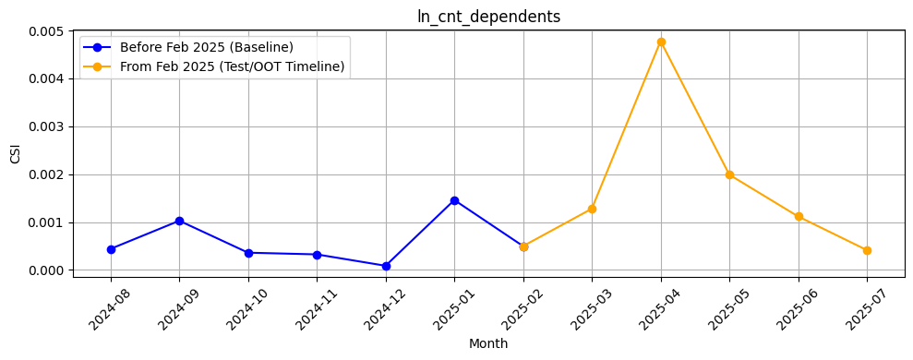
Rank# 7: ln_cnt_dependents ( 4 / 4 ) - Feature CSI Analysis <Applied>
CSI values during the baseline period (Aug 2024 to Jan 2025) were consistently low, all under 0.0015.
A temporary spike was observed in Apr 2025 (~0.0048), followed by a gradual decline through Jul 2025.
All CSI values remained far below the 0.1 threshold, indicating no significant data drift.

Slide 46
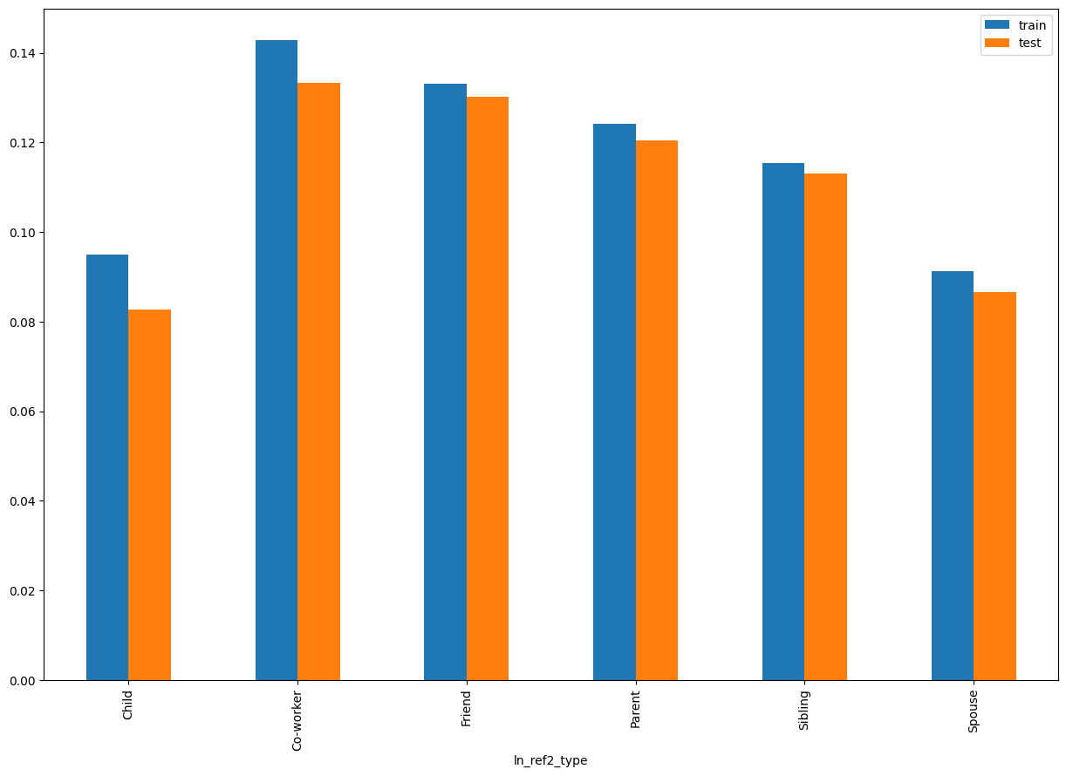
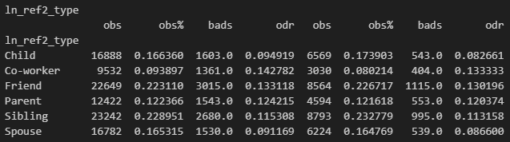
Rank# 8: ln_ref2_type ( 1 / 4 ) - Feature Performance in Train vs Test <Disbursed>
Relationship of the second reference person to the individual (e.g., sibling, friend, spouse).

Slide 47
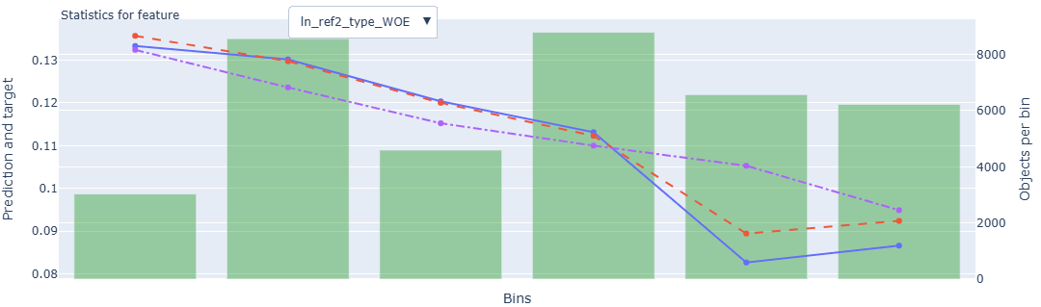
Rank# 8: ln_ref2_type ( 2 / 4 ) - Feature Statistics Analysis <Disbursed>
The red and blue lines are closely aligned, validating the model’s use of this feature.
The consistent gap from the purple substituted prediction line further confirms the feature’s predictive value.
Green bars show a well-balanced spread across WOE bins, supporting stable model learning.
A clear decrease in the target rate is observed across bins, aligning with WOE logic and improving model stratification of risk profiles.
47

Slide 48
Rank# 8: ln_ref2_type ( 3 / 4 ) - MoM Feature Distribution <Applied>
ln_ref2_type | Applied Count | Approval Rate | Sibling | Friend | Child | Spouse | Parent | Co-worker |  | Avg. Demo Score
2024-08 | 25,136 | 60.0% | 23.1% | 24.0% | 14.4% | 14.5% | 13.0% | 11.1% |  | 0.49806503
2024-09 | 25,284 | 59.4% | 23.2% | 24.6% | 14.2% | 14.5% | 12.6% | 11.0% |  | 0.49974565
2024-10 | 23,980 | 58.9% | 23.5% | 23.1% | 15.3% | 15.0% | 12.7% | 10.5% |  | 0.49468015
2024-11 | 24,399 | 62.2% | 23.2% | 22.9% | 15.9% | 15.6% | 12.5% | 9.8% |  | 0.48374065
2024-12 | 48,407 | 59.4% | 22.5% | 22.3% | 16.4% | 16.2% | 12.8% | 9.8% |  | 0.48802628
2025-01 | 23,044 | 58.1% | 23.0% | 23.2% | 15.4% | 16.3% | 13.0% | 9.1% |  | 0.49425928
2025-02 | 20,636 | 59.0% | 23.6% | 23.3% | 16.1% | 15.3% | 12.9% | 8.8% |  | 0.49441829
2025-03 | 25,000 | 61.0% | 23.7% | 23.9% | 16.1% | 15.4% | 12.5% | 8.3% |  | 0.48966094
2025-04 | 26,389 | 62.3% | 23.9% | 23.4% | 16.3% | 15.1% | 13.4% | 7.9% |  | 0.48805174
2025-05 | 26,406 | 61.8% | 23.4% | 22.9% | 16.9% | 16.0% | 13.4% | 7.5% |  | 0.48956425
2025-06 | 22,903 | 65.3% | 23.4% | 22.4% | 17.7% | 15.8% | 12.9% | 7.7% |  | 0.48503991
2025-07 | 16,160 | 64.7% | 23.8% | 22.8% | 17.5% | 16.0% | 12.9% | 7.0% |  | 0.48868890
"Friend" and "Sibling" categories lead consistently around 23–24%, while "Child" and "Spouse" show a gradual upward trend into the 16–18% range.
"Parent" and "Co-worker" proportions decline slightly over time, moving from 13.0% and 11.1% to 12.9% and 7.0% respectively, indicating slow user shift.
No spikes or drop-offs are observed, and all relationship types maintain a smooth trend—confirming feature stability for referral behavior modeling.
48

Slide 49
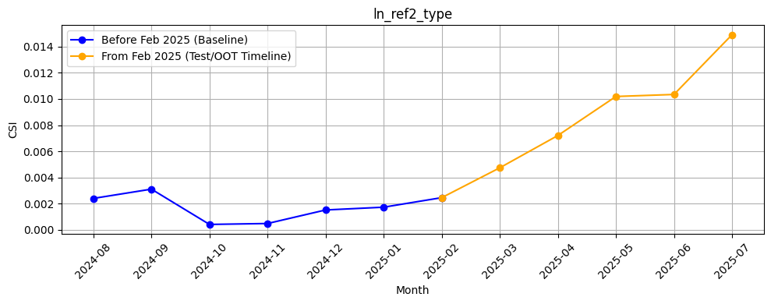
Rank# 8: ln_ref2_type ( 4 / 4 ) - Feature CSI Analysis <Applied>
CSI values in the baseline period (Aug 2024 to Jan 2025) were consistently low, all below 0.003.
A gradual and consistent increase was seen during the Test/OOT period (Feb to Jul 2025), peaking at ~0.0146 in Jul 2025.
Despite the upward trend, all values stayed well below the 0.1 threshold, indicating no significant data drift.

Slide 50
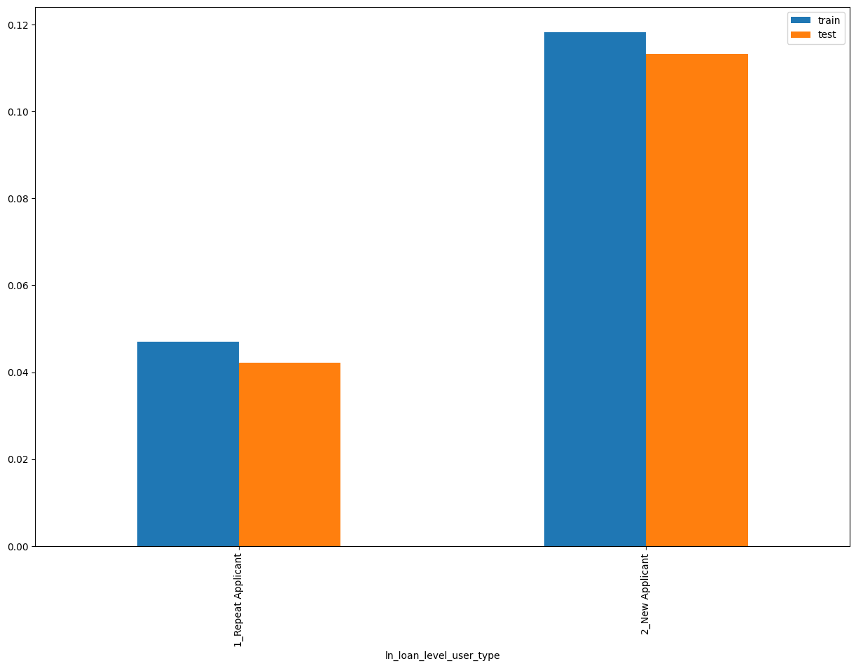
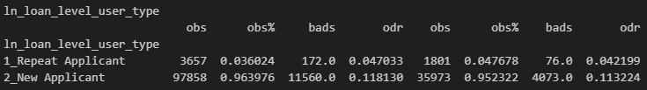
Rank# 9: ln_loan_level_user_type ( 1 / 4 ) - Feature Performance in Train vs Test <Disbursed>
It represents user type whether a new or repeat (repeat if the customer had any disbursed loans in the past with Tonik else new)

Slide 51
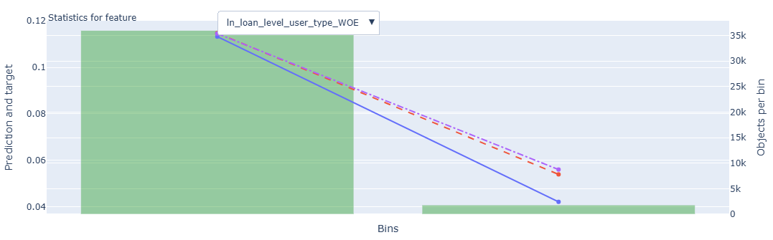
Rank# 9: ln_loan_level_user_type ( 2 / 4 ) - Feature Statistics Analysis <Disbursed>
The red prediction line follows the blue target line with precision, showing the model effectively leverages this feature.
A significant gap from the purple baseline prediction indicates this feature boosts model performance.
The green bars indicate strong class imbalance, with new applicants heavily dominating over repeat ones.
The target rate is notably lower for repeat applicants, highlighting their association with reduced risk. This makes the feature valuable in distinguishing user segments.
51

Slide 52
Rank# 9: ln_loan_level_user_type ( 3 / 4 ) - MoM Feature Distribution <Applied>
ln_loan_level_user_type | Applied Count | Approval Rate | 2_New Applicant | 1_Repeat Applicant |  | Avg. Demo Score
2024-08 | 25,136 | 60.0% | 97.4% | 2.6% |  | 0.49806503
2024-09 | 25,284 | 59.4% | 97.2% | 2.8% |  | 0.49974565
2024-10 | 23,980 | 58.9% | 96.6% | 3.4% |  | 0.49468015
2024-11 | 24,399 | 62.2% | 95.7% | 4.3% |  | 0.48374065
2024-12 | 48,407 | 59.4% | 96.9% | 3.1% |  | 0.48802628
2025-01 | 23,044 | 58.1% | 96.4% | 3.6% |  | 0.49425928
2025-02 | 20,636 | 59.0% | 95.6% | 4.4% |  | 0.49441829
2025-03 | 25,000 | 61.0% | 95.2% | 4.8% |  | 0.48966094
2025-04 | 26,389 | 62.3% | 95.1% | 4.9% |  | 0.48805174
2025-05 | 26,406 | 61.8% | 96.1% | 3.9% |  | 0.48956425
2025-06 | 22,903 | 65.3% | 95.4% | 4.6% |  | 0.48503991
2025-07 | 16,160 | 64.7% | 96.0% | 4.0% |  | 0.48868890
“New Applicant” share remains dominant, ranging from 95.1% to 97.4%, with minor fluctuations across months indicating steady portfolio composition.
“Repeat Applicant” increases slightly in early 2025 (up to 4.9%) before tapering back to 4.0%, reflecting a minor yet stable re-engagement trend.
Overall, category shares shift gradually without abrupt swings, confirming high reliability for modeling user segmentation.
52

Slide 53
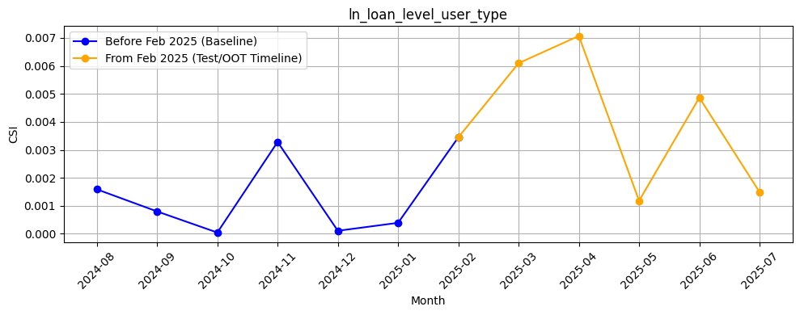
Rank# 9: ln_loan_level_user_type ( 4 / 4 ) - Feature CSI Analysis <Applied>
CSI values during the baseline period (Aug 2024 to Jan 2025) remained low and stable, all under 0.0035.
A rise was observed during the Test/OOT period (Feb to Jul 2025), peaking at ~0.007 in Apr 2025 and fluctuating modestly thereafter.
All values remained well below the 0.1 threshold, confirming strong feature stability with no signs of data drift.
53

Slide 54
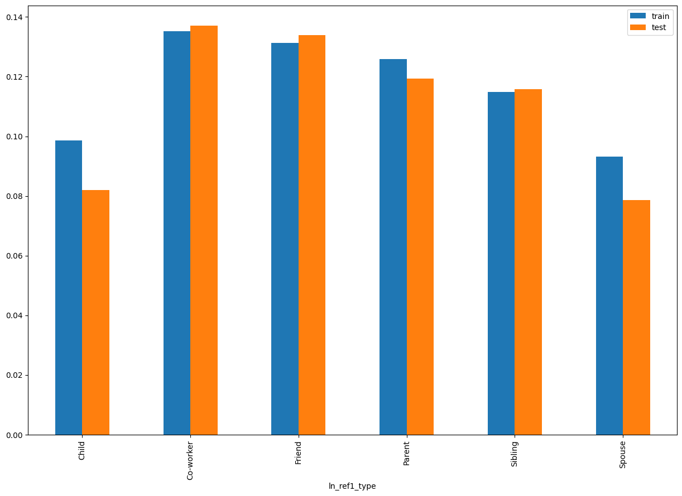
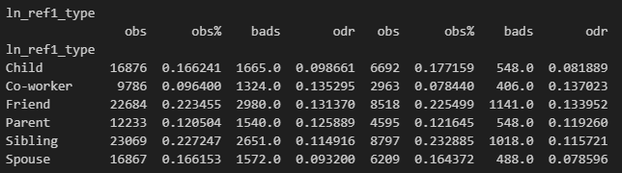
Rank# 10: ln_ref1_type ( 1 / 4 ) - Feature Performance in Train vs Test <Disbursed>
Relationship of the first reference person to the individual (e.g., sibling, friend, spouse).

Slide 55
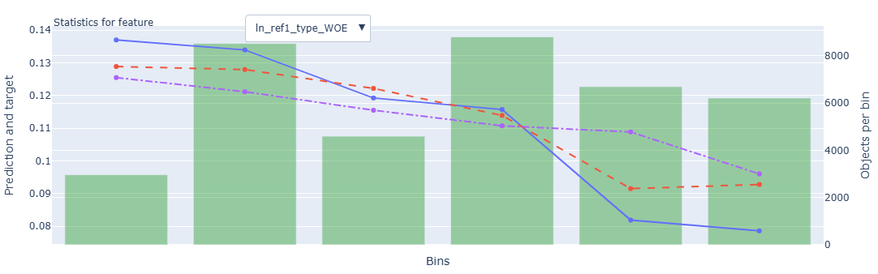
Rank# 10: ln_ref1_type ( 2 / 4 ) - Feature Statistics Analysis <Disbursed>
The model is leveraging this feature well, with the red prediction line following the blue target line’s trend reasonably closely.
The gap between the red and purple lines remains consistent across bins, suggesting the feature adds predictive value.
The green bars reveal a balanced distribution across bins, with a slight concentration in middle segments.
The target rate decreases steadily across bins, aligning with the WOE transformation and reinforcing the feature’s value in identifying less risky profiles.
55

Slide 56
Rank# 10: ln_ref1_type ( 3 / 4 ) - MoM Feature Distribution <Applied>
ln_ref1_type | Applied Count | Approval Rate | Sibling | Friend | Child | Spouse | Parent | Co-worker |  | Avg. Demo Score
2024-08 | 25,136 | 60.0% | 23.0% | 24.0% | 14.0% | 14.9% | 12.6% | 11.4% |  | 0.49806503
2024-09 | 25,284 | 59.4% | 23.3% | 23.9% | 14.5% | 14.5% | 12.8% | 11.0% |  | 0.49974565
2024-10 | 23,980 | 58.9% | 22.8% | 23.4% | 14.9% | 15.1% | 13.1% | 10.7% |  | 0.49468015
2024-11 | 24,399 | 62.2% | 22.4% | 23.3% | 16.1% | 16.1% | 12.5% | 9.6% |  | 0.48374065
2024-12 | 48,407 | 59.4% | 22.5% | 22.4% | 16.4% | 16.0% | 12.6% | 10.1% |  | 0.48802628
2025-01 | 23,044 | 58.1% | 23.0% | 23.2% | 15.9% | 16.2% | 12.8% | 8.9% |  | 0.49425928
2025-02 | 20,636 | 59.0% | 24.1% | 23.2% | 16.1% | 15.3% | 12.6% | 8.7% |  | 0.49441829
2025-03 | 25,000 | 61.0% | 23.8% | 23.6% | 16.3% | 15.6% | 12.7% | 8.0% |  | 0.48966094
2025-04 | 26,389 | 62.3% | 23.8% | 23.6% | 16.3% | 15.3% | 13.2% | 7.8% |  | 0.48805174
2025-05 | 26,406 | 61.8% | 23.8% | 22.6% | 16.9% | 16.1% | 13.2% | 7.5% |  | 0.48956425
2025-06 | 22,903 | 65.3% | 23.4% | 22.7% | 17.4% | 16.1% | 12.7% | 7.7% |  | 0.48503991
2025-07 | 16,160 | 64.7% | 23.6% | 22.9% | 17.1% | 16.1% | 13.0% | 7.3% |  | 0.48868890
"Sibling" and "Friend" categories consistently lead the distribution (~23–24%), indicating stable reference preferences over time.
"Child" and "Spouse" see gradual growth, reaching 17.4% and 16.1% by Jul 2025, suggesting increasing family-based references.
All categories remain well within stable bands, with no volatility, reinforcing the feature’s dependability for referral behavior modeling.
56

Slide 57
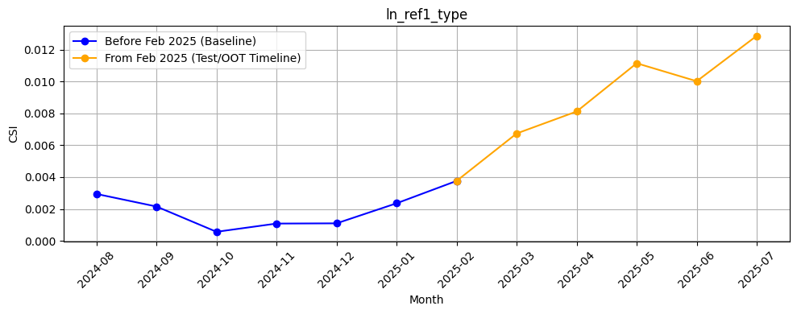
Rank# 10: ln_ref1_type ( 4 / 4 ) - Feature CSI Analysis <Applied>
CSI values in the baseline period (Aug 2024 to Jan 2025) were consistently low, staying below 0.003.
From Feb to Jul 2025, a steady increase was observed, with CSI peaking at ~0.0128 in Jul 2025.
Despite the upward trend, all values remained well under the 0.1 threshold, confirming no significant data drift.

Slide 58
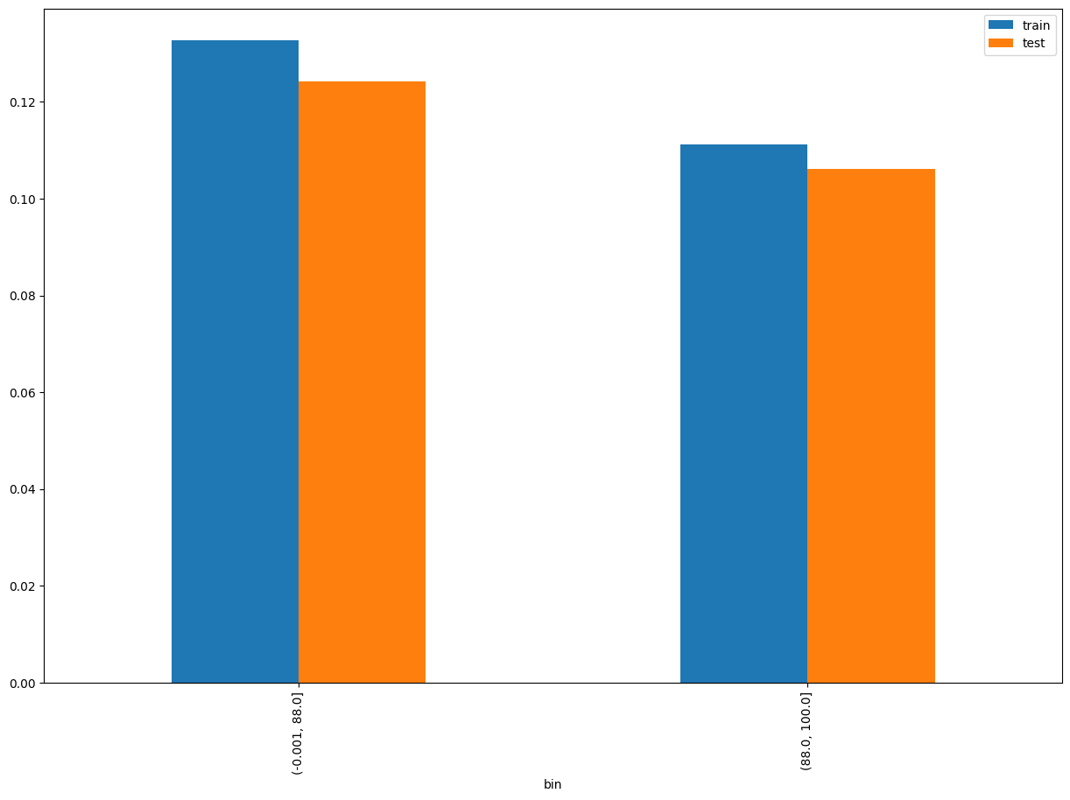
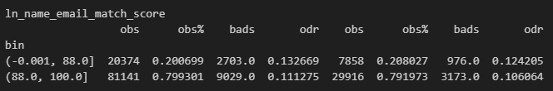
Rank# 11: ln_name_email_match_score ( 1 / 5 ) - Feature Performance in Train vs Test <Disbursed>
This feature captures the similarity score between the applicant’s name and email ID, indicating potential identity consistency.
58
Please note these are just WOE Bins, NOT the final Bins that Catboost chooses internally

Slide 59


Rank# 11: ln_name_email_match_score ( 2 / 5 ) - Histogram <Disbursed>
Bad customers (blue line) show more variation in scores across a wider range. Good customers (red line) are concentrated at the higher end (close to 100), indicating that better matches between name and email are associated with lower risk likelihood.
Most customers cluster at the extreme right (scores near 100), showing a strong positive match between names and emails. The Train+Validation (green) and Test+OOT (orange) sets show consistent distributions, indicating stable model behavior across data splits.

Slide 60

Rank# 11: ln_name_email_match_score ( 3 / 5 ) - Feature Statistics Analysis <Disbursed>
The red line (model prediction) diverges from the blue target line at multiple points, suggesting limited predictive consistency across all bins.
The gap between the red and purple lines is narrow, indicating this feature adds marginal predictive value.
Green bars indicate that most data points are concentrated in the rightmost bin, showing a strong right-skew.
Target behavior is highly volatile in lower bins but stabilizes toward the higher end — implying some signal is captured at extreme values.

Slide 61
Rank# 11: ln_name_email_match_score ( 4 / 5 ) - MoM Mean Distribution <Applied>
ln_name_email_match_score | Applied Count | Approval Rate | Mean |  | Avg. Demo Score
2024-08 | 25,136 | 60.0% | 89.23 |  | 0.49806503
2024-09 | 25,284 | 59.4% | 89.24 |  | 0.49974565
2024-10 | 23,980 | 58.9% | 89.41 |  | 0.49468015
2024-11 | 24,399 | 62.2% | 89.49 |  | 0.48374065
2024-12 | 48,407 | 59.4% | 89.84 |  | 0.48802628
2025-01 | 23,044 | 58.1% | 89.56 |  | 0.49425928
2025-02 | 20,636 | 59.0% | 89.14 |  | 0.49441829
2025-03 | 25,000 | 61.0% | 89.17 |  | 0.48966094
2025-04 | 26,389 | 62.3% | 88.87 |  | 0.48805174
2025-05 | 26,406 | 61.8% | 89.31 |  | 0.48956425
2025-06 | 22,903 | 65.3% | 88.95 |  | 0.48503991
2025-07 | 16,160 | 64.7% | 89.30 |  | 0.48868890
The mean score remains tightly clustered, ranging from 88.87 to 89.84, with no significant shifts over the entire observed period.
A minor dip in Apr 2025 is visible, but recovery follows immediately, ruling out any structural disruption in user verification behavior.
The feature maintains excellent stability month-over-month, making it highly suitable for trustworthiness or identity-related modeling.
61

Slide 62

Rank# 11: ln_name_email_match_score ( 5 / 5 ) - Feature CSI Analysis <Applied>
CSI values during the baseline period (Aug 2024 to Jan 2025) were extremely low, consistently under 0.0002.
A few minor peaks were observed in the Test/OOT period (Feb to Jul 2025), with the highest CSI around 0.00095 in Apr 2025.
All values remained far below the 0.1 threshold, confirming excellent feature stability and no sign of data drift.

Slide 63


Rank# 12: ln_telconame ( 1 / 4 ) - Feature Performance in Train vs Test <Disbursed>
This feature refers to the mobile telecom provider used by the applicant, such as DITO, Globe, or Smart.

Slide 64

Rank# 12: ln_telconame ( 2 / 4 ) - Feature Statistics Analysis <Disbursed>
The model uses this feature effectively, with the prediction (red) line closely mirroring the target (blue) trend.
The consistent separation from the substituted prediction (purple) indicates good contribution to model performance.
Data distribution is heavily left-skewed, with one bin dominating in volume.
Target rate shows a distinct drop-off, supporting this feature’s ability to segment risk.

Slide 65
Rank# 12: ln_telconame ( 3 / 4 ) - MoM Feature Distribution <Applied>
ln_telconame | Applied Count | Approval Rate | Smart | Globe | DITO |  | Avg. Demo Score
2024-08 | 25,136 | 60.0% | 45.8% | 44.3% | 10.0% |  | 0.49806503
2024-09 | 25,284 | 59.4% | 44.5% | 45.0% | 10.5% |  | 0.49974565
2024-10 | 23,980 | 58.9% | 45.8% | 43.5% | 10.6% |  | 0.49468015
2024-11 | 24,399 | 62.2% | 45.3% | 44.1% | 10.6% |  | 0.48374065
2024-12 | 48,407 | 59.4% | 46.3% | 43.0% | 10.7% |  | 0.48802628
2025-01 | 23,044 | 58.1% | 45.4% | 43.6% | 11.0% |  | 0.49425928
2025-02 | 20,636 | 59.0% | 45.3% | 44.0% | 10.7% |  | 0.49441829
2025-03 | 25,000 | 61.0% | 45.8% | 43.1% | 11.2% |  | 0.48966094
2025-04 | 26,389 | 62.3% | 46.1% | 43.4% | 10.5% |  | 0.48805174
2025-05 | 26,406 | 61.8% | 46.7% | 42.4% | 10.9% |  | 0.48956425
2025-06 | 22,903 | 65.3% | 45.8% | 43.5% | 10.7% |  | 0.48503991
2025-07 | 16,160 | 64.7% | 45.2% | 43.2% | 11.6% |  | 0.48868890
“Smart” and “Globe” maintain leading shares in near-parity, both ranging between 43–46%, with minimal directional drift.
“DITO” remains a minority player throughout (10.0%–11.6%), exhibiting stable presence without abrupt expansion or decline.
All telco segments show smooth trends without spikes, confirming a reliable and noise-free input for model consumption.

Slide 66

Rank# 12: ln_telconame ( 4 / 4 ) - Feature CSI Analysis <Applied>
CSI values during the baseline period (Aug 2024 to Jan 2025) remained very low, all well under 0.001.
The Test/OOT period (Feb to Jul 2025) showed minor fluctuations, peaking at ~0.001 in Jul 2025.
Despite the movement, CSI values stayed far below the 0.1 threshold, confirming strong feature stability and no data drift.

Slide 67


Rank# 13: ln_city_cat ( 1 / 4 ) - Feature Performance in Train vs Test <Disbursed>
It indicates the applicant's declared city of residence during the loan application.

Slide 68

Rank# 13: ln_city_cat ( 2 / 4 ) - Feature Statistics Analysis <Disbursed>
The red line mostly follows the blue line, but noticeable deviations in some bins indicate inconsistencies.
The prediction-substitution gap is evident, confirming the model uses this feature for risk separation.
Green bars highlight a heavily right-skewed distribution, with many bins containing very few observations.
The downward trend in target rate across bins supports the usefulness of this feature.

Slide 69
Rank# 13: ln_city_cat ( 3 / 4 ) - MoM Feature Distribution <Applied>
ln_city_cat | Applied Count | Approval Rate | others | city of caloocan | quezon city | city of taguig | antipolo | city of mandaluyong | san jose del monte | city of valenzuela | rodriguez montalban | dasmarinas | binangonan | city of muntinlupa | city of makati | calamba | cebu city | city of pasig | city of malabon | santa rosa | tanza | general trias | city of marikina | silang | lapu lapu city | trece martires city | san pablo city | rosario |  | Avg. Demo Score
2024-08 | 25,136 | 60.0% | 55.5% | 4.9% | 4.4% | 3.7% | 1.6% | 2.0% | 1.8% | 2.2% | 1.4% | 1.6% | 1.3% | 1.8% | 1.6% | 0.9% | 1.5% | 1.5% | 1.6% | 1.9% | 1.2% | 1.2% | 1.1% | 1.1% | 1.3% | 1.0% | 0.9% | 1.0% |  | 0.49806503
2024-09 | 25,284 | 59.4% | 56.0% | 4.7% | 3.9% | 3.3% | 1.6% | 2.0% | 1.8% | 1.8% | 1.4% | 1.9% | 1.4% | 1.8% | 1.4% | 0.9% | 1.8% | 1.6% | 1.1% | 1.7% | 1.1% | 1.3% | 1.2% | 1.2% | 1.6% | 1.1% | 1.3% | 0.9% |  | 0.49974565
2024-10 | 23,980 | 58.9% | 55.8% | 4.7% | 3.8% | 3.6% | 2.0% | 2.0% | 1.8% | 1.9% | 1.7% | 2.0% | 1.3% | 1.7% | 1.5% | 1.0% | 1.5% | 1.3% | 1.3% | 1.6% | 1.0% | 1.2% | 1.1% | 1.2% | 1.4% | 1.2% | 1.4% | 0.8% |  | 0.49468015
2024-11 | 24,399 | 62.2% | 56.4% | 4.9% | 4.0% | 3.1% | 2.0% | 1.8% | 2.2% | 2.1% | 2.0% | 2.0% | 1.7% | 1.6% | 1.5% | 1.1% | 1.0% | 1.5% | 1.4% | 1.1% | 1.1% | 1.1% | 1.2% | 1.1% | 1.3% | 1.2% | 0.9% | 1.0% |  | 0.48374065
2024-12 | 48,407 | 59.4% | 57.6% | 4.3% | 3.5% | 2.8% | 1.9% | 1.8% | 2.0% | 2.0% | 2.2% | 1.8% | 1.7% | 1.3% | 1.2% | 1.5% | 1.4% | 1.2% | 1.3% | 1.1% | 1.1% | 1.2% | 1.2% | 1.3% | 1.5% | 1.2% | 0.9% | 1.0% |  | 0.48802628
2025-01 | 23,044 | 58.1% | 59.2% | 3.6% | 3.4% | 2.5% | 1.9% | 1.9% | 2.1% | 1.6% | 1.8% | 2.0% | 1.7% | 1.4% | 1.2% | 1.4% | 1.4% | 1.2% | 1.1% | 1.0% | 1.1% | 1.2% | 1.1% | 1.4% | 1.8% | 1.0% | 1.0% | 1.0% |  | 0.49425928
2025-02 | 20,636 | 59.0% | 58.8% | 3.8% | 3.1% | 2.5% | 2.3% | 1.9% | 2.1% | 1.7% | 1.9% | 1.6% | 2.0% | 1.4% | 1.6% | 1.1% | 1.6% | 1.4% | 1.3% | 1.0% | 1.2% | 0.9% | 1.2% | 1.1% | 1.8% | 0.9% | 0.9% | 0.9% |  | 0.49441829
2025-03 | 25,000 | 61.0% | 59.4% | 3.8% | 3.6% | 2.7% | 2.1% | 2.2% | 2.1% | 2.1% | 2.0% | 1.6% | 1.7% | 1.2% | 1.4% | 1.3% | 1.0% | 1.3% | 1.3% | 1.2% | 1.2% | 1.2% | 1.1% | 1.1% | 0.6% | 1.0% | 1.0% | 0.9% |  | 0.48966094
2025-04 | 26,389 | 62.3% | 59.5% | 3.8% | 3.5% | 2.8% | 1.9% | 2.2% | 2.0% | 1.9% | 2.0% | 1.7% | 1.5% | 1.3% | 1.5% | 1.5% | 1.0% | 1.2% | 1.3% | 1.3% | 1.3% | 1.3% | 1.2% | 0.9% | 0.5% | 1.2% | 0.8% | 1.0% |  | 0.48805174
2025-05 | 26,406 | 61.8% | 61.1% | 3.6% | 3.6% | 2.4% | 2.4% | 2.1% | 1.6% | 1.8% | 2.2% | 1.5% | 1.6% | 1.1% | 1.4% | 1.7% | 1.0% | 0.9% | 1.1% | 1.1% | 1.5% | 1.2% | 1.3% | 1.0% | 0.4% | 1.0% | 0.7% | 0.9% |  | 0.48956425
2025-06 | 22,903 | 65.3% | 59.5% | 4.1% | 3.6% | 2.5% | 2.4% | 2.2% | 2.0% | 2.1% | 1.9% | 1.6% | 1.7% | 1.2% | 1.3% | 1.5% | 0.9% | 1.0% | 1.0% | 1.0% | 1.4% | 1.1% | 1.2% | 1.1% | 0.4% | 1.3% | 0.9% | 1.0% |  | 0.48503991
2025-07 | 16,160 | 64.7% | 61.2% | 3.8% | 3.3% | 2.5% | 2.2% | 1.9% | 2.0% | 2.0% | 2.2% | 1.5% | 1.5% | 1.3% | 1.3% | 1.5% | 0.9% | 0.9% | 1.1% | 1.0% | 1.4% | 1.2% | 1.1% | 1.2% | 0.5% | 1.1% | 0.9% | 0.7% |  | 0.48868890
“Others” remains the dominant category, gradually increasing from 55.5% in Aug 2024 to 61.2% by Jul 2025, indicating a widening geographic spread beyond key cities.
High-volume cities like “Caloocan”, “Quezon City”, and “Taguig” show minor fluctuations but maintain stable contributions between 3–5%, ensuring a predictable city-wise mix.
All other cities remain below 3%, with no abrupt surges or drops, confirming a clean, stable distribution across regions suitable for location-based modeling.

Slide 70

Rank# 13: ln_city_cat ( 4 / 4 ) - Feature CSI Analysis <Applied>
CSI during the baseline period (Aug 2024 to Jan 2025) stayed consistently low, below 0.01.
A steady increase was seen during the Test/OOT period (Feb to Jul 2025), peaking at ~0.035 in May 2025.
All CSI values remained well below the 0.1 threshold, indicating no evidence of significant data drift.

Slide 71


Rank# 14: ln_brand_bin ( 1 / 4 ) - Feature Performance in Train vs Test <Disbursed>
This feature captures the mobile brand used during the loan application.

Slide 72

Rank# 14: ln_brand_bin ( 2 / 4 ) - Feature Statistics Analysis <Disbursed>
The model leverages this feature well; red and blue lines generally follow similar trends.
A clear separation from the purple line (substituted prediction) shows that the feature adds discriminatory power.
Green bars show moderately balanced distribution, though some bins have considerably more data.
Target rate generally declines with increasing bin values, reflecting risk separation.

Slide 73
Rank# 14: ln_brand_bin ( 3 / 4 ) - MoM Feature Distribution <Applied>
ln_brand_bin | Applied Count | Approval Rate | vivo | oppo | realme | samsung | infinix | apple | redmi | tecno | honor | others | itel | huawei | missing |  | Avg. Demo Score
2024-08 | 25,136 | 60.0% | 18.0% | 18.5% | 13.9% | 11.4% | 8.9% | 8.7% | 6.5% | 5.9% | 2.6% | 2.7% | 1.2% | 1.7% | 0.0% |  | 0.49806503
2024-09 | 25,284 | 59.4% | 18.2% | 18.1% | 13.9% | 11.3% | 9.7% | 8.5% | 6.4% | 5.8% | 2.9% | 2.5% | 1.3% | 1.6% | 0.0% |  | 0.49974565
2024-10 | 23,980 | 58.9% | 17.2% | 17.7% | 14.5% | 10.9% | 9.9% | 8.8% | 6.7% | 6.3% | 2.6% | 2.6% | 1.4% | 1.5% | 0.0% |  | 0.49468015
2024-11 | 24,399 | 62.2% | 17.7% | 17.3% | 13.0% | 11.6% | 10.3% | 8.7% | 6.4% | 6.1% | 3.3% | 2.6% | 1.6% | 1.4% | 0.0% |  | 0.48374065
2024-12 | 48,407 | 59.4% | 17.7% | 17.0% | 13.5% | 11.3% | 10.4% | 8.3% | 6.4% | 6.5% | 2.9% | 2.9% | 1.6% | 1.4% | 0.0% |  | 0.48802628
2025-01 | 23,044 | 58.1% | 16.8% | 16.7% | 12.9% | 11.8% | 10.5% | 9.4% | 6.4% | 6.7% | 3.3% | 2.7% | 1.6% | 1.2% | 0.0% |  | 0.49425928
2025-02 | 20,636 | 59.0% | 16.7% | 16.3% | 13.1% | 11.8% | 10.4% | 9.7% | 6.5% | 6.6% | 3.3% | 2.9% | 1.5% | 1.1% | 0.0% |  | 0.49441829
2025-03 | 25,000 | 61.0% | 15.9% | 15.7% | 12.6% | 11.7% | 10.5% | 10.8% | 6.6% | 6.4% | 4.0% | 3.1% | 1.5% | 1.3% | 0.0% |  | 0.48966094
2025-04 | 26,389 | 62.3% | 15.7% | 15.7% | 11.7% | 11.5% | 10.4% | 11.9% | 6.7% | 6.5% | 4.1% | 3.0% | 1.5% | 1.2% | 0.0% |  | 0.48805174
2025-05 | 26,406 | 61.8% | 15.8% | 15.6% | 12.0% | 11.2% | 10.9% | 11.2% | 6.3% | 6.9% | 4.4% | 3.1% | 1.6% | 1.1% | 0.0% |  | 0.48956425
2025-06 | 22,903 | 65.3% | 15.7% | 15.1% | 11.8% | 11.6% | 10.8% | 11.3% | 6.8% | 6.7% | 4.5% | 2.9% | 1.8% | 1.1% | 0.0% |  | 0.48503991
2025-07 | 16,160 | 64.7% | 15.5% | 15.3% | 11.2% | 11.6% | 11.5% | 11.5% | 6.6% | 6.8% | 4.5% | 3.0% | 1.7% | 0.9% | 0.0% |  | 0.48868890
Leading brands “Vivo” and “Oppo” show a slow and steady decline from ~18% to ~15.5% by Jul 2025, indicating a gradual shift in device preference.
Mid-tier brands like “Samsung”, “Infinix”, and “Apple” grow steadily, with Apple increasing from 8.7% to 11.5%, reflecting rising usage among applicants.
All brand segments shift gradually without volatility, and “missing” stays at 0% throughout—confirming high data quality and feature stability.

Slide 74

Rank# 14: ln_brand_bin ( 4 / 4 ) - Feature CSI Analysis <Applied>
CSI during the baseline period (Aug 2024 to Jan 2025) was consistently low, all under 0.005.
A clear upward trend was observed in the Test/OOT period (Feb to Jul 2025), with CSI rising steadily and peaking at ~0.031 in Jul 2025.
All values remained well below the 0.1 threshold, indicating no significant data drift despite the rising pattern.

Slide 75


Rank# 15: ln_apply_Is_Weekend ( 1 / 4 ) - Feature Performance in Train vs Test <Disbursed>
This feature indicates whether the applicant applied on a weekday or weekend.

Slide 76

Rank# 15: ln_apply_Is_Weekend ( 2 / 4 ) - Feature Statistics Analysis <Disbursed>
The red and blue lines follow a simple two-bin pattern, indicating the model uses this binary feature directly.
The gap between red and purple lines is very minimal indicating the less predictive power of the feature though it is a least most feature.
Green bars show balanced record counts between weekend and weekday applications.
The target rate is lower on weekends, indicating stronger disbursement likelihood during weekdays.

Slide 77
Rank# 15: ln_apply_Is_Weekend ( 3 / 4 ) - MoM Feature Distribution <Applied>
ln_apply_Is_Weekend | Applied Count | Approval Rate | Weekday | Weekend |  | Avg. Demo Score
2024-08 | 25,136 | 60.0% | 62.33% | 37.67% |  | 0.49806503
2024-09 | 25,284 | 59.4% | 60.38% | 39.62% |  | 0.49974565
2024-10 | 23,980 | 58.9% | 65.85% | 34.15% |  | 0.49468015
2024-11 | 24,399 | 62.2% | 61.69% | 38.31% |  | 0.48374065
2024-12 | 48,407 | 59.4% | 65.86% | 34.14% |  | 0.48802628
2025-01 | 23,044 | 58.1% | 66.07% | 33.93% |  | 0.49425928
2025-02 | 20,636 | 59.0% | 62.08% | 37.92% |  | 0.49441829
2025-03 | 25,000 | 61.0% | 58.99% | 41.01% |  | 0.48966094
2025-04 | 26,389 | 62.3% | 67.98% | 32.02% |  | 0.48805174
2025-05 | 26,406 | 61.8% | 64.88% | 35.12% |  | 0.48956425
2025-06 | 22,903 | 65.3% | 61.99% | 38.01% |  | 0.48503991
2025-07 | 16,160 | 64.7% | 62.67% | 37.33% |  | 0.48868890
Weekday applications remain dominant throughout, ranging between 58.9% and 68.0%, peaking in Apr 2025, indicating a strong weekday user preference.
Weekend share fluctuates between 32.0% and 41.0%, with the highest observed in Mar 2025, but generally remains secondary to weekday activity.
Overall, the split between weekday and weekend remains balanced and smooth, with no anomalies, confirming high temporal consistency in application timing.

Slide 78

Rank# 15: ln_apply_Is_Weekend ( 4 / 4 ) - Feature CSI Analysis <Applied>
CSI remained low and stable throughout the baseline period (Aug 2024 to Jan 2025), peaking at ~0.0055 in Sep 2024.
A brief spike occurred in Mar 2025 (~0.0103), followed by a steady decline through Jul 2025.
All values stayed far below the 0.1 threshold, confirming no meaningful data drift.

Slide 79

THANK YOU!
​
Questions?
tonikbank.com

